Slide 1
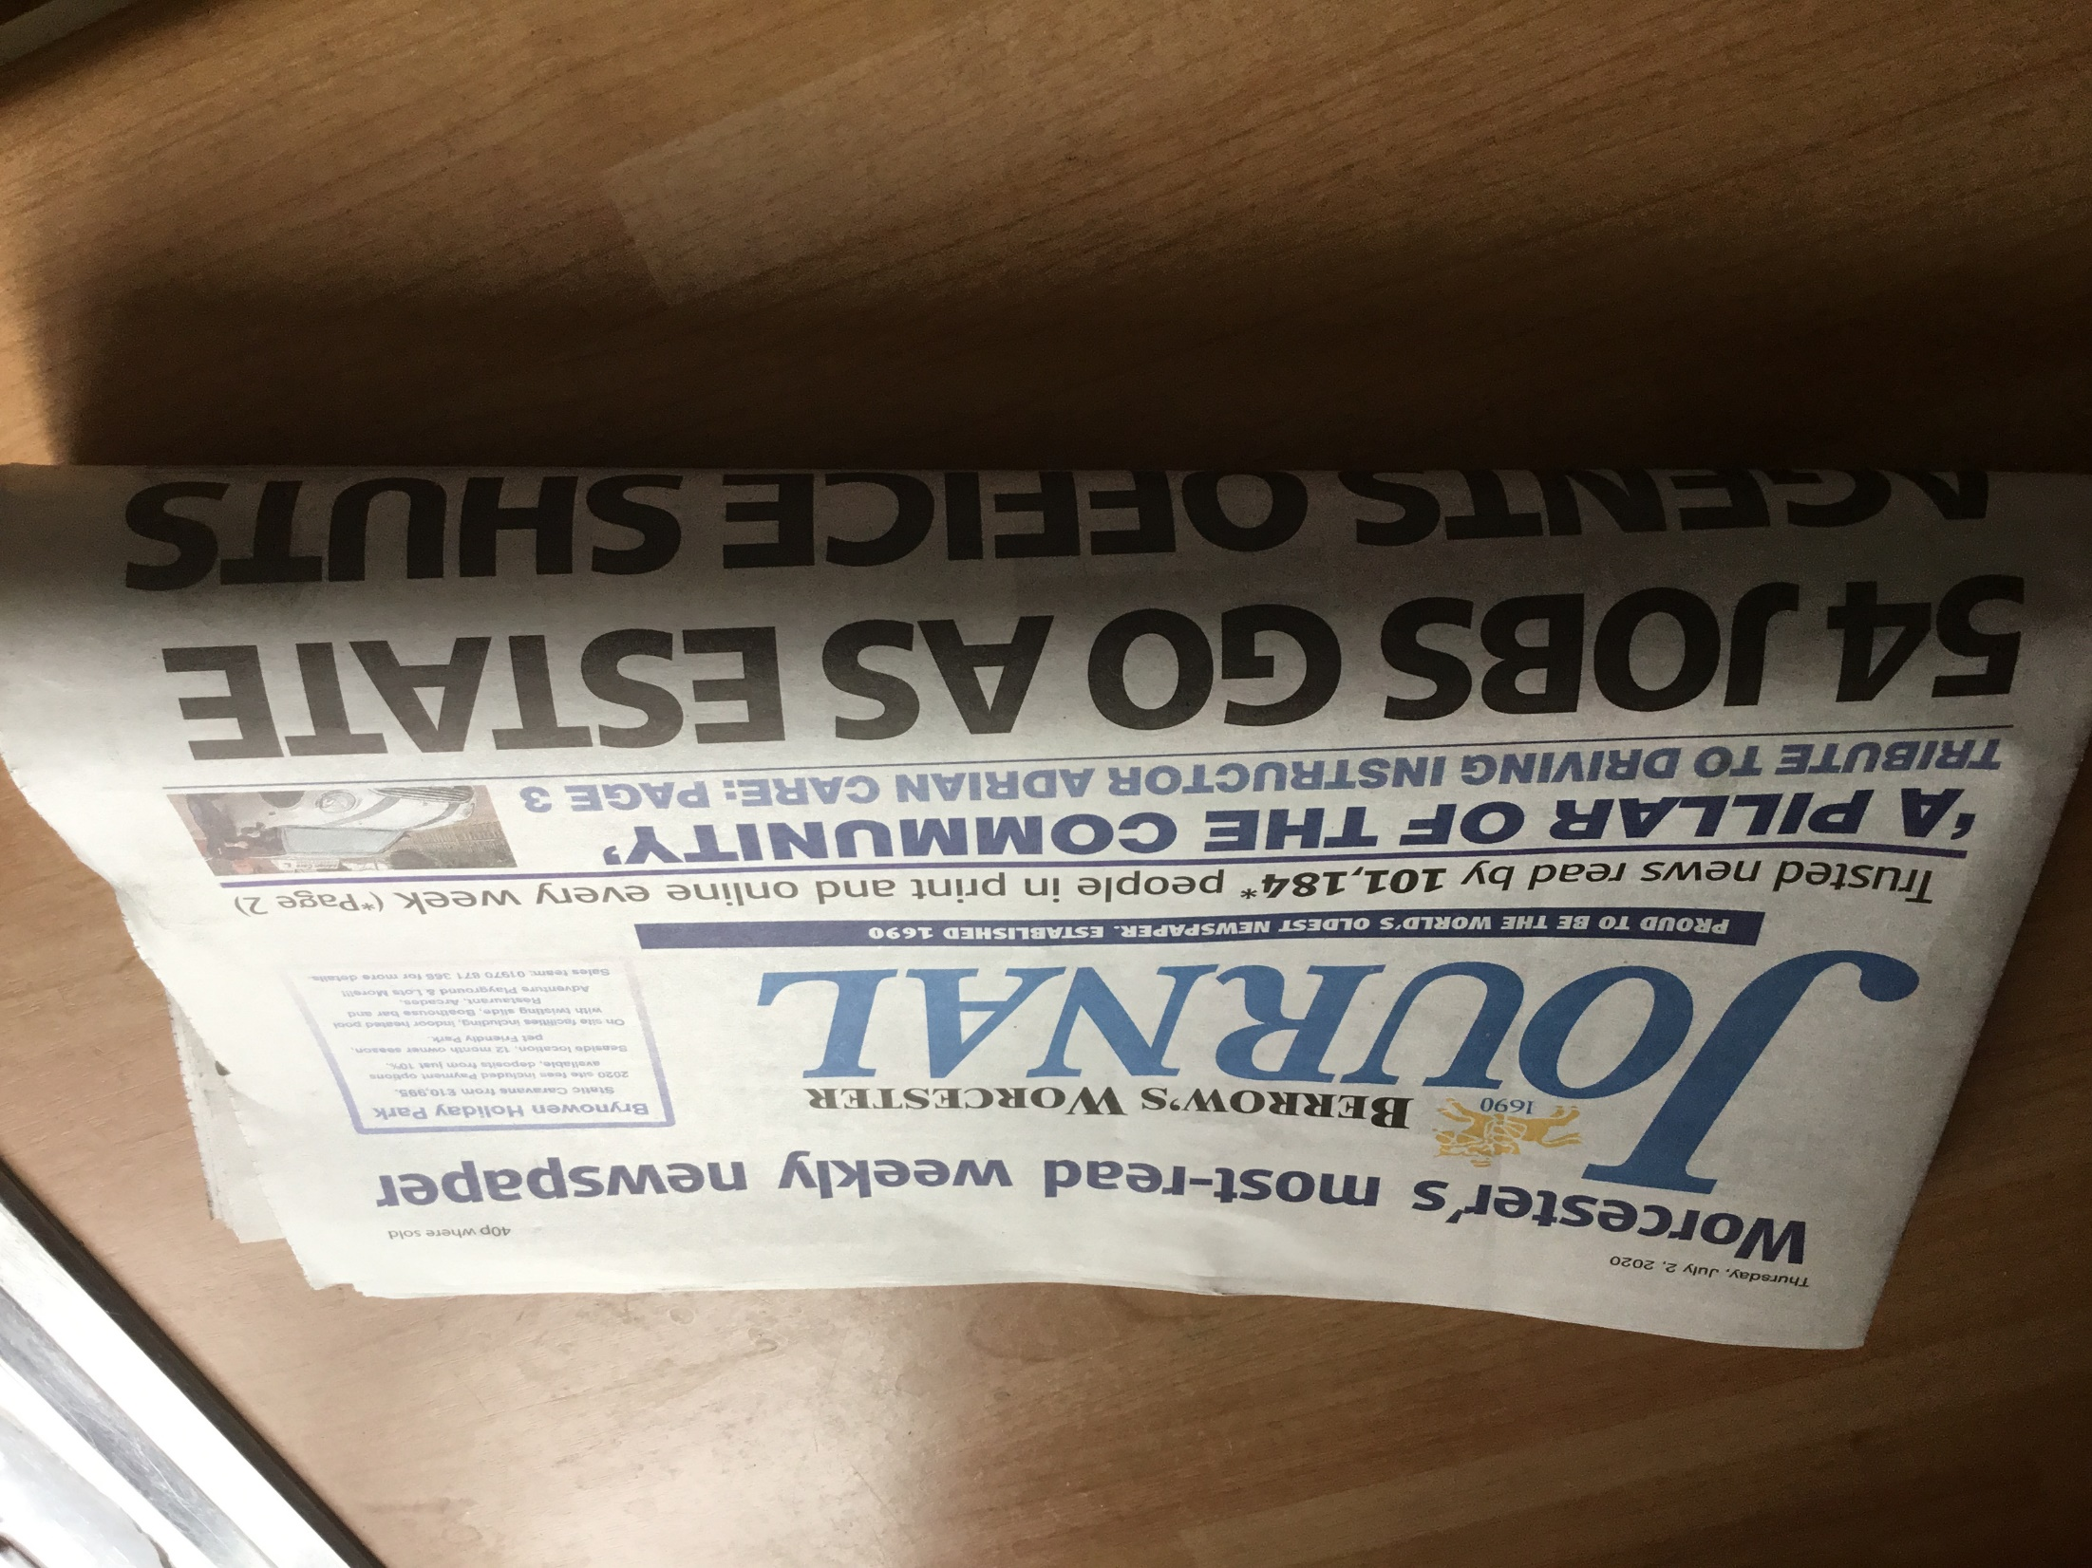
Mrs Art’s Sketchbook Ideas
Newspapers…
What do you do with a pile of old newspapers…
Pulp them and Create things!
I’ve made 5 different shapes…
What can you create?

Slide 2
Paper Mache Pulp
Rip or shred your newspaper
Soak in hot water for a few hours (or over night)
Grab handfuls of pulp and squeeze out the excess water
Mix PVA glue into your pulp with your hands
You really need to squish it together
Mix it for ages! Squish it through your fingers or toes!

Slide 3
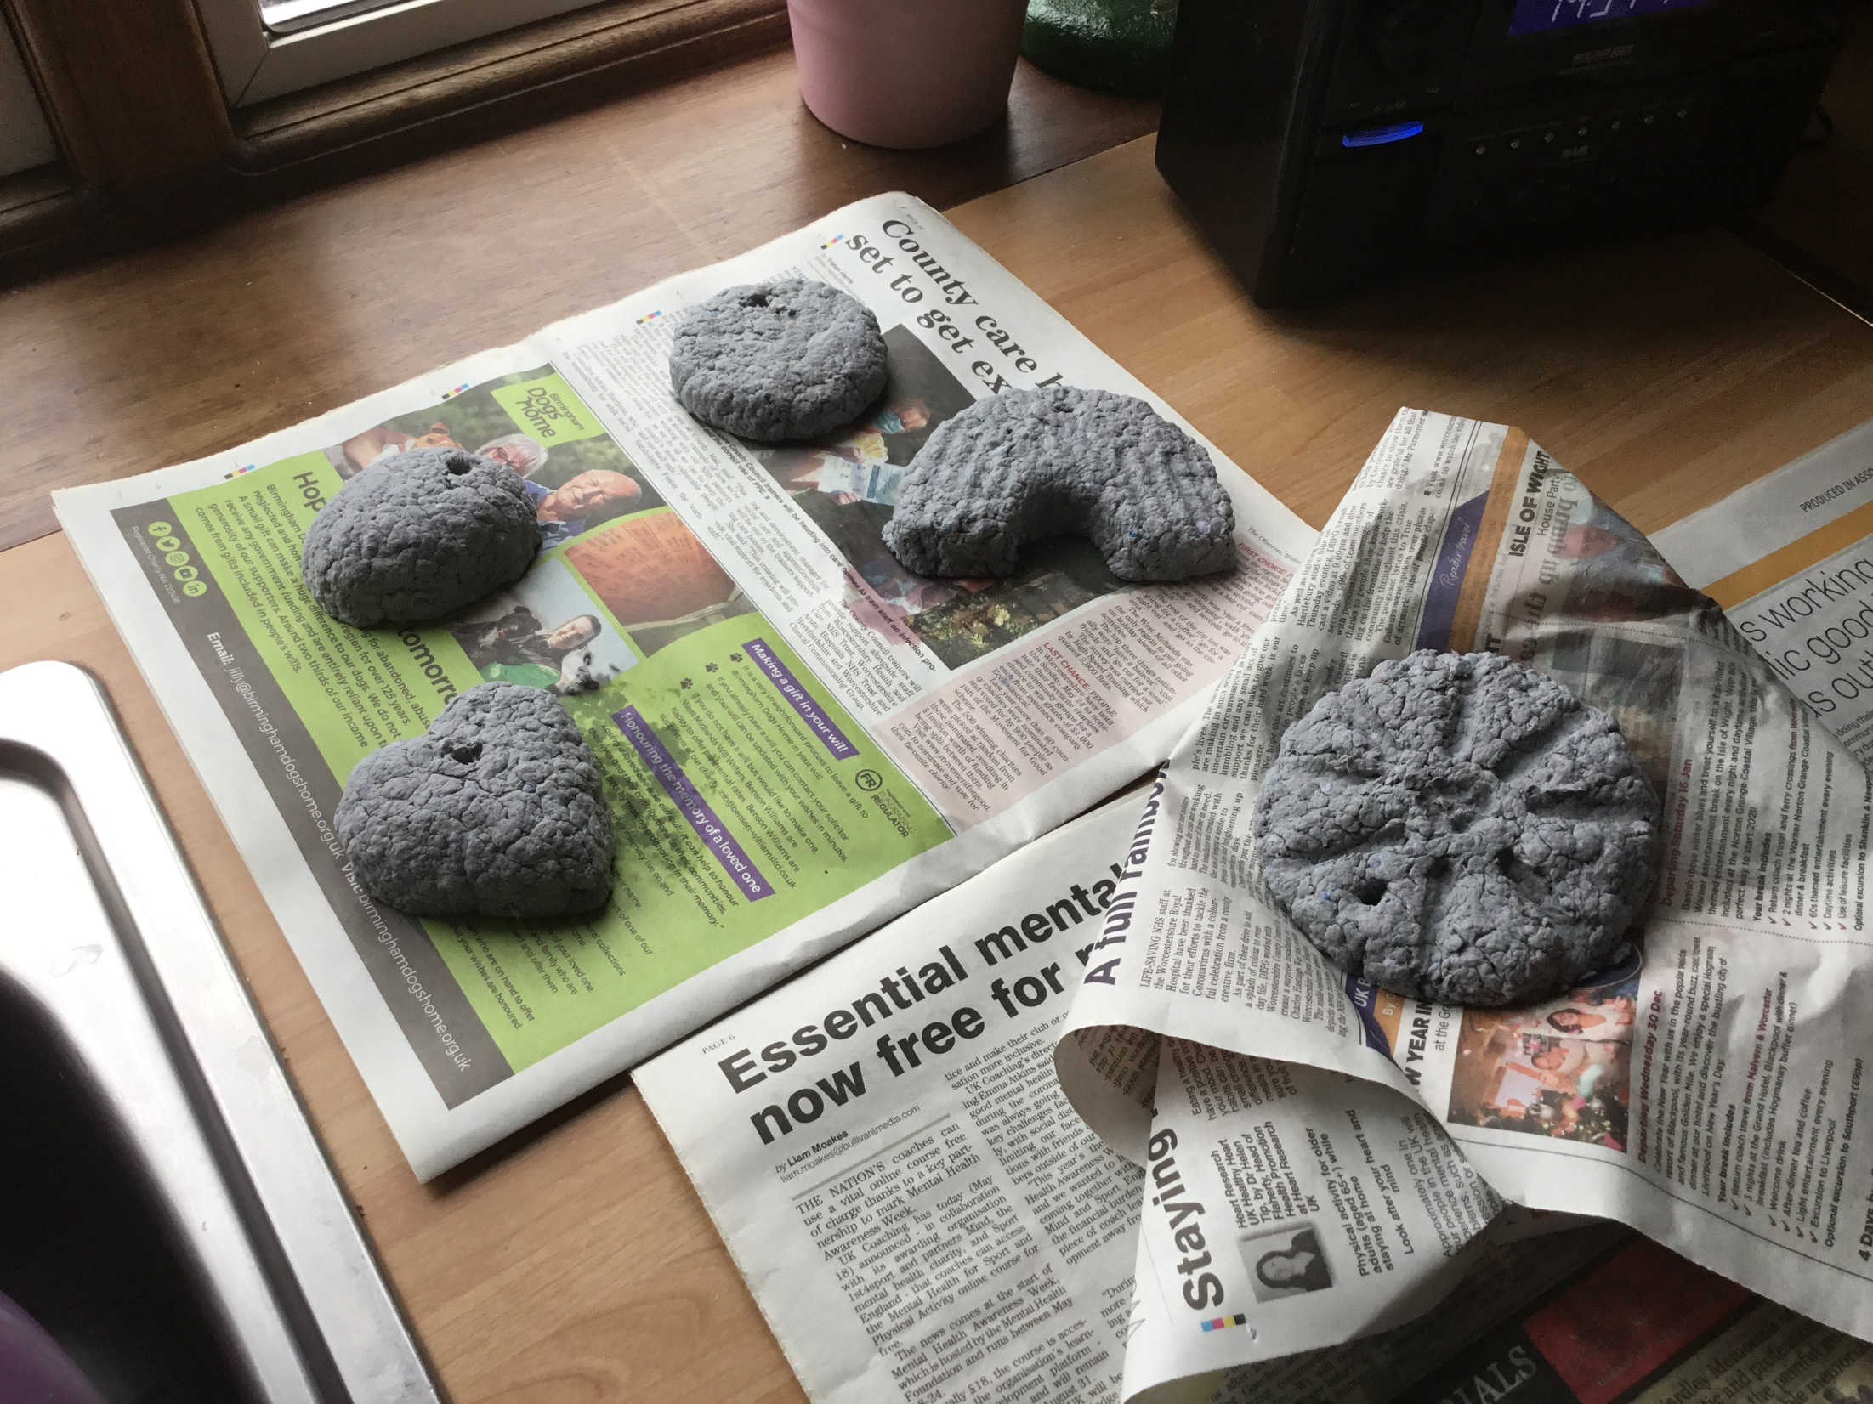
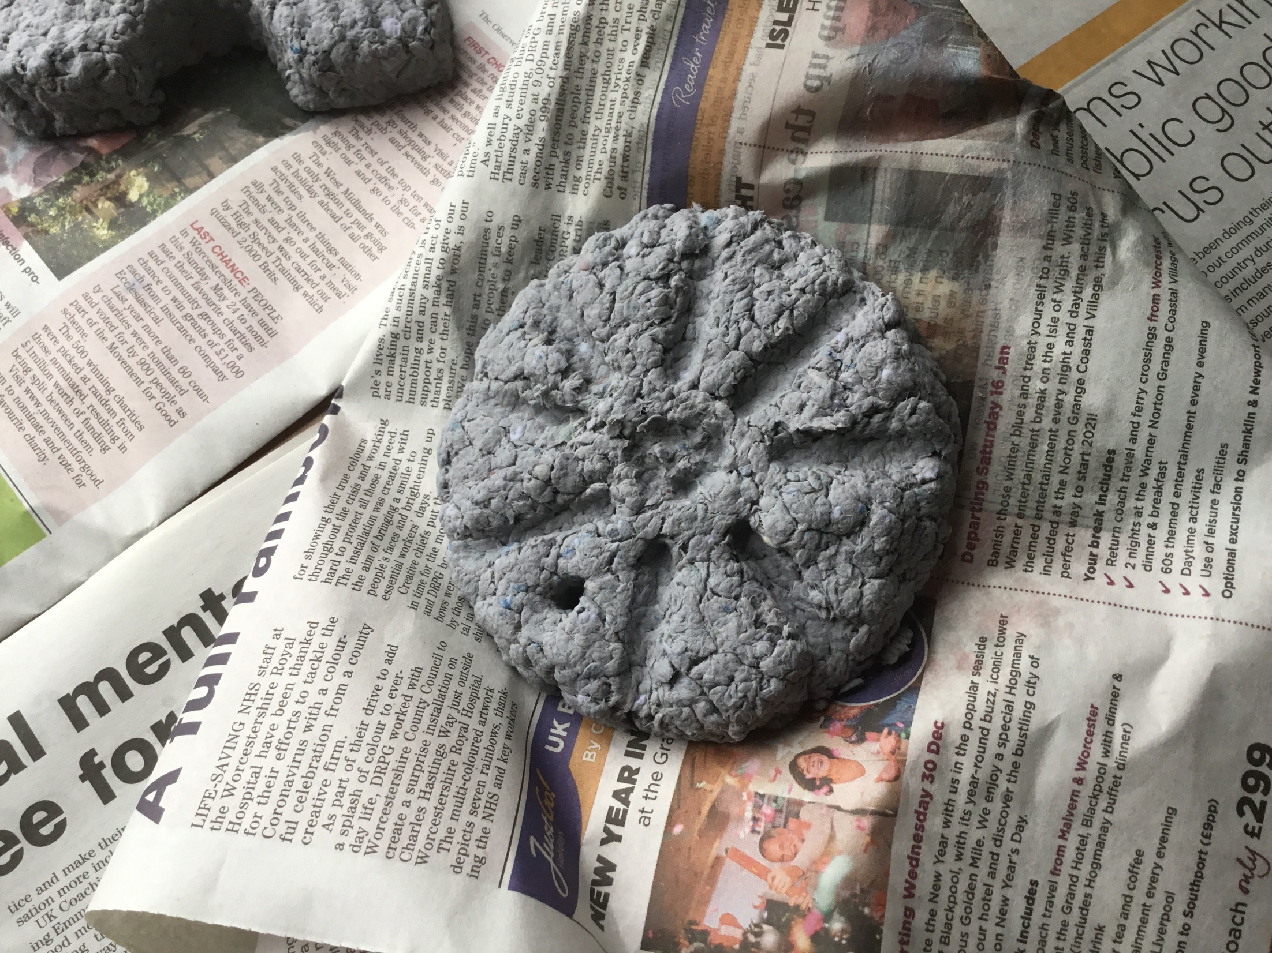
Shapes
Squish your pulp into shapes
You can choose any shape
You need to really squish it so that the pulp sticks together…
*I made a hole in the shapes so I can hang them up when they are dry…
Leave your shapes to dry for a few days in a warm, dry place.
Your airing cupboard maybe?
Or out in the sunshine…

Slide 4
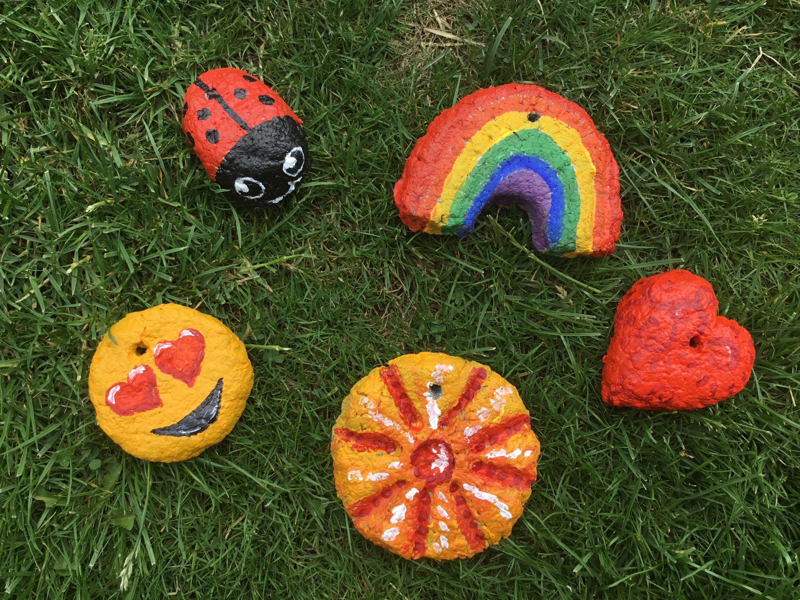
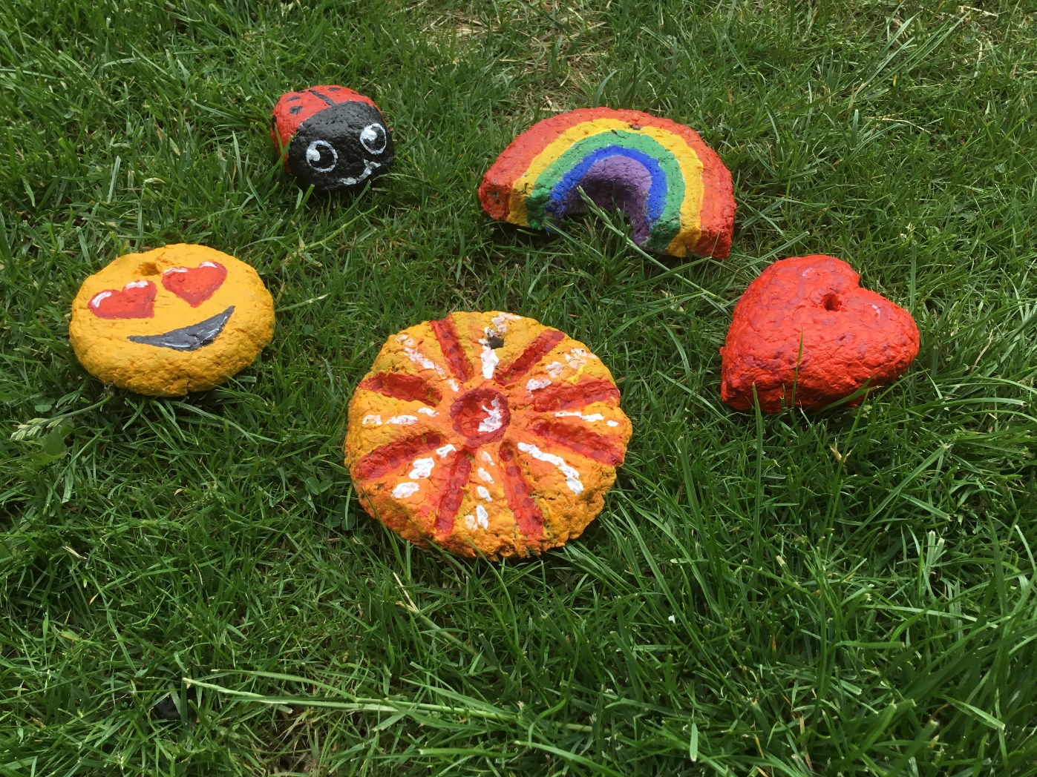
And now for Paint!
Once your shapes feel dry you can add paint
I used Acrylic paint which works well
You could use water based paints and finish with a layer of PVA glue if you prefer

Slide 5
And back to sketching practice in our Sketchbooks!
I have chosen another famous painting.
Vincent Van Gogh
‘L’Eglise d’Auvers’.
1890
I have sketched out all of the detail using gold pen.
This made me look at the picture really closely.
Why don’t you have a go!

