Slide 1
My DofE Home Activities

Slide 2
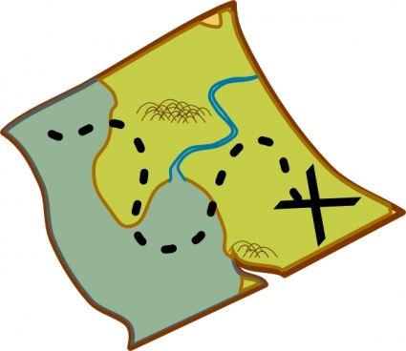
The DofE is……
Whilst we are all staying safe at home to stop the spread of the carona virus.
We can continue with some DofE activities

Slide 3
The sections
Volunteering
These are the four sections
of the DofE.
Keep a diary of your
activities whilst you are
at home that will
count towards your
DofE Award.
Skills
Physical
Expedition

Slide 4
The DofE is……
Volunteering Ideas
Environmental Tasks
Help Parents around the house with:
Sorting washing, emptying bins,
vacuuming, laying the table, dusting
Sort old clothes to go to the
charity shop.
Recycle at home
Plant some herbs or seeds
Upcycling an old item
Environmental activity ideas
https://www.highspeedtraining.co.uk/hub/environmental-awareness-for-kids/
Upcycling ideas
https://handsonaswegrow.com/34-recyclables-to-upcycle-for-the-kids
Information about how to make an eco brick
https://www.ecobricks.org/

Slide 5
Physical Ideas
Staying fit and healthy
Play an active game on the
Wii, xbox, playstation
Learn a new dance routine
Play a ball game in the garden
Go for a daily walk
Follow a yoga session on
the internet
Active ideas for at home
https://www.goodhousekeeping.com/uk/health/health-advice/a31697332/staying-fit-healthy-self-isolating
Yoga for children, including stories
https://www.cosmickids.com/
Get fit with Joe Wicks
https://www.youtube.com/watch?v=88Ot2ReVHkw

Slide 6
Skill Ideas
Make a healthy snack each day
Help cook meals
Learn to use the washing machine
Or cooker
Learn to use the vacuum.
Pair up clean socks
Learn how to code with Spark 4 Kids
Learn sign language
Lots of visual and practical support for teaching you everyday tasks around the house
https://www.staffordshireconnects.info/kb5/staffordshire/directory/service.page?id=JtaaRY6sDPA

Slide 7
Expedition ideas
Build a den
(in the house or garden)
Learn the name of 3 trees
Count and complete a
bird survey
In your garden
Look at a map and learn 3
symbols
Adventure and Fun:
Activities about birds and conducting a bird survey
https://www.rspb.org.uk/fun-and-learning/for-teachers/schools-birdwatch/resources/
Map symbols bingo game
https://www.getoutwiththekids.co.uk/activities/playing-things/map-symbol-bingo/
Activity ideas using maps for children
https://getoutside.ordnancesurvey.co.uk/guides/map-reading-skills-for-children/

Slide 8
The DofE is…
Have lots of fun
Email your photos and evidence to Emma Nolan
ejn24@chadsgrove.worcs.sch.uk

