Slide 1
Celebrating the hard work of Chadsgrove pupils DofE sections at home
DofE with a difference
12.5.20

Slide 2
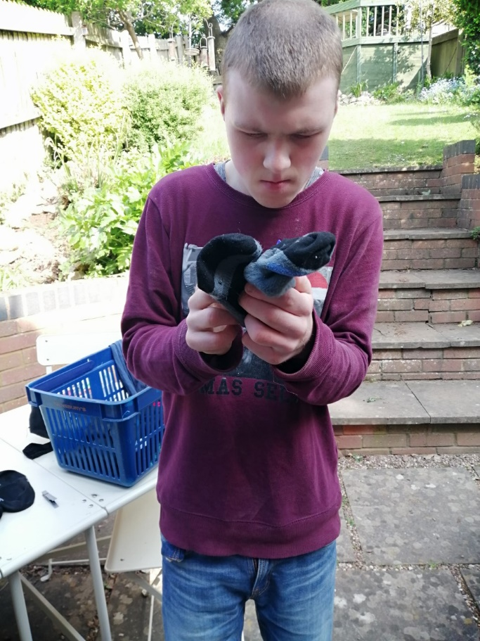
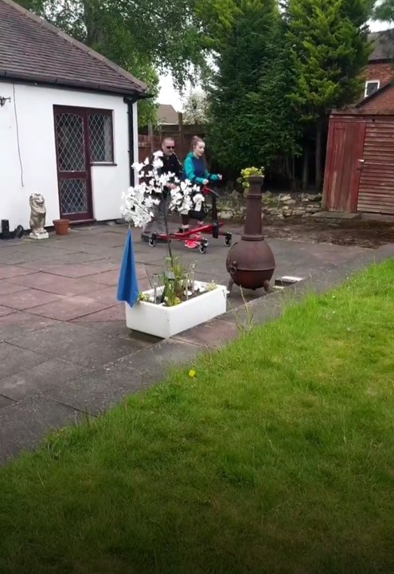
Gemma is walking a 100 laps of her driveway to raise money for the NHS!
This is a brilliant volunteering idea and helping a great cause too!
Billy- Helping to sort the washing

Slide 3
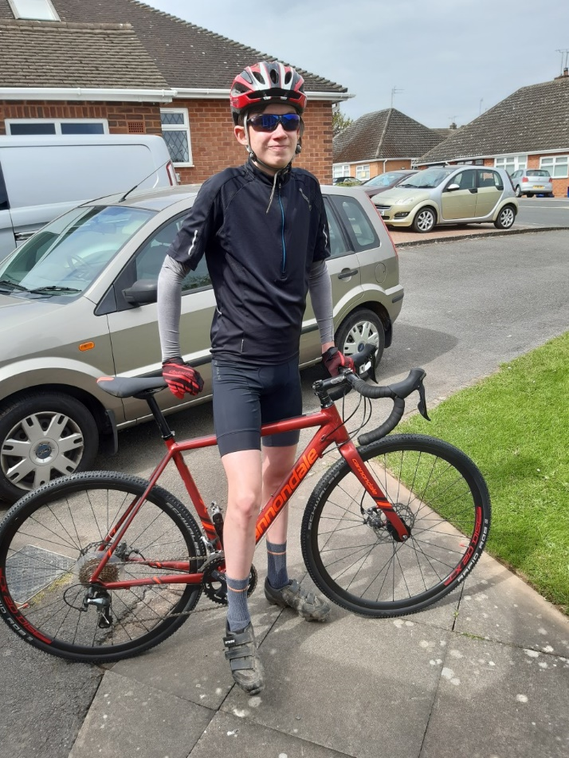
Cerys is wheelchair dancing via a zoom call class
Will is going on bike rides with his family

Slide 4
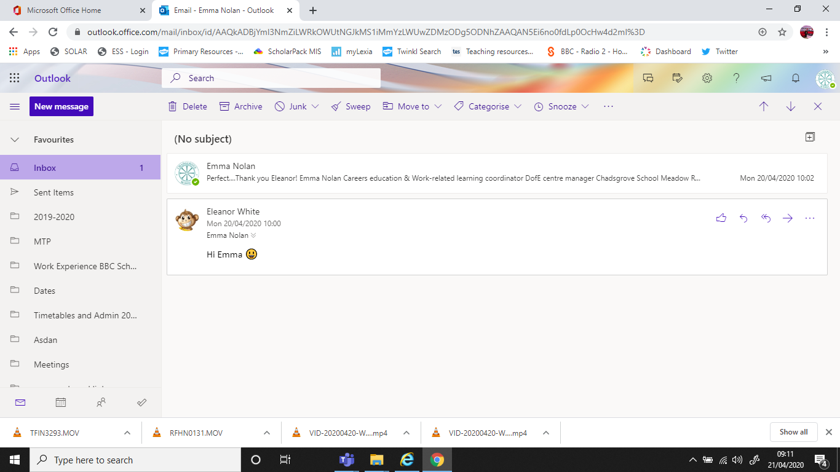
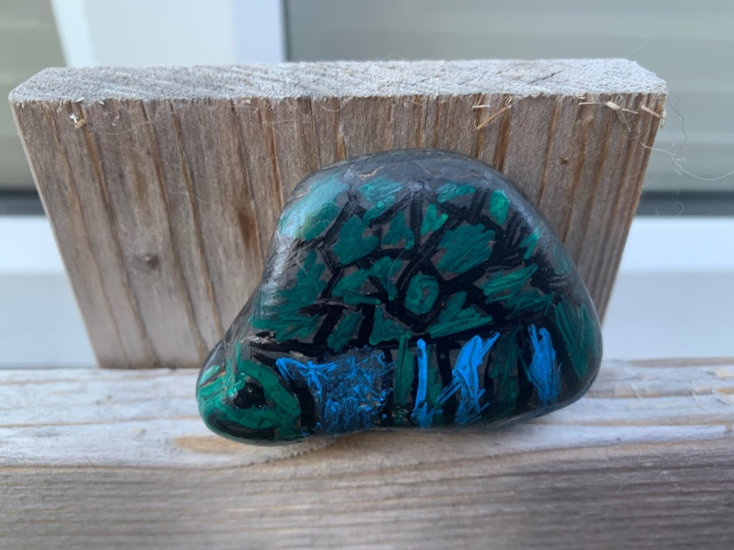
Sam is getting very creative
Eleanor is learning how to send emails

Slide 5
Well done everyone- Your updates and photos are amazing!
Please keep up the hard work!
Send all your photos and updates to me by email or if the files are too big use WeTransfer
My email address is: ejn24@chadsgrove.worcs.sch.uk

