Slide 1
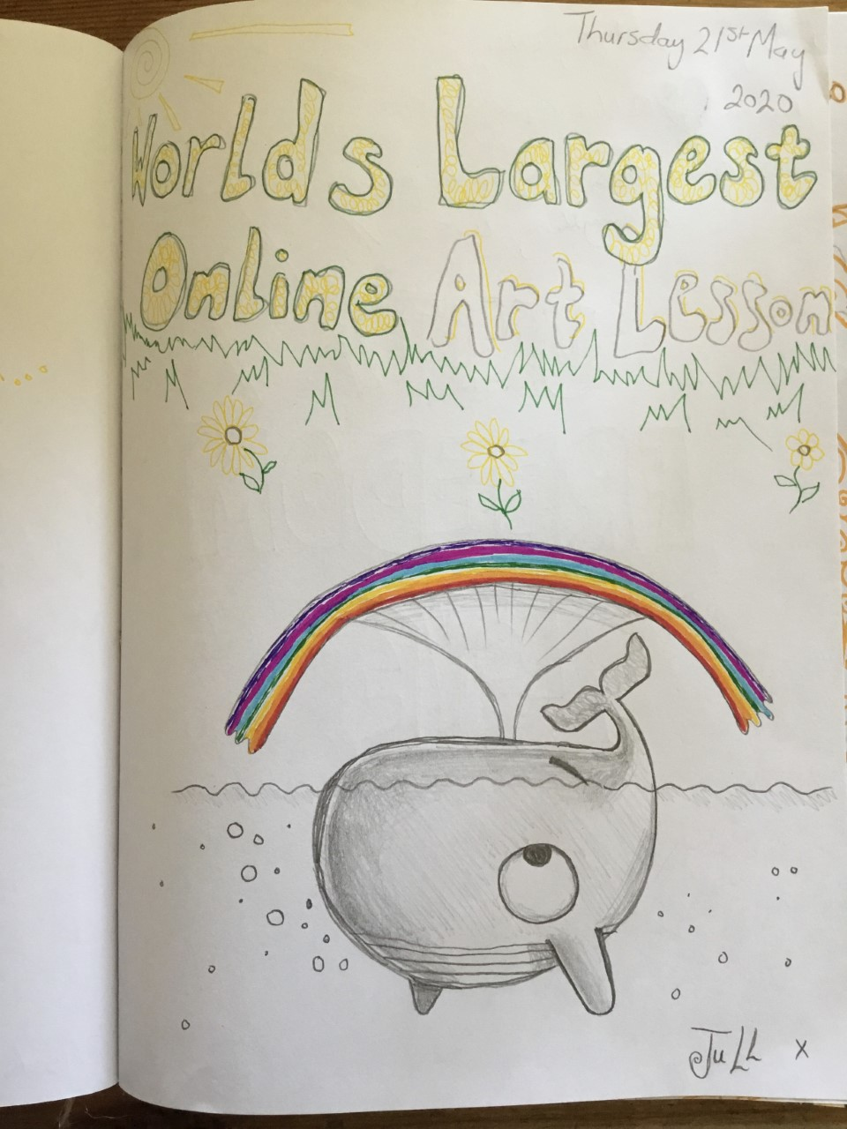
Cartoons
#Draw with Rob
Did you join the world’s biggest art lesson?
(Thursday 21st May 2020)
If you did, I would love to see your picture!
Here is my picture..
A whale and a rainbow!

Slide 2
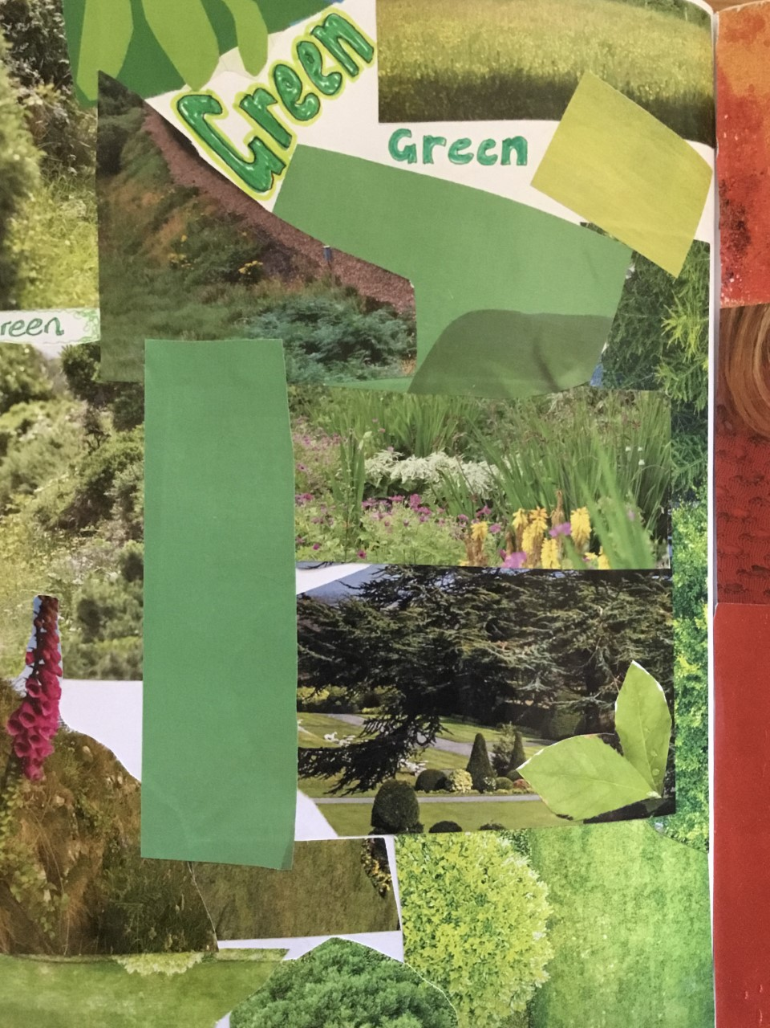
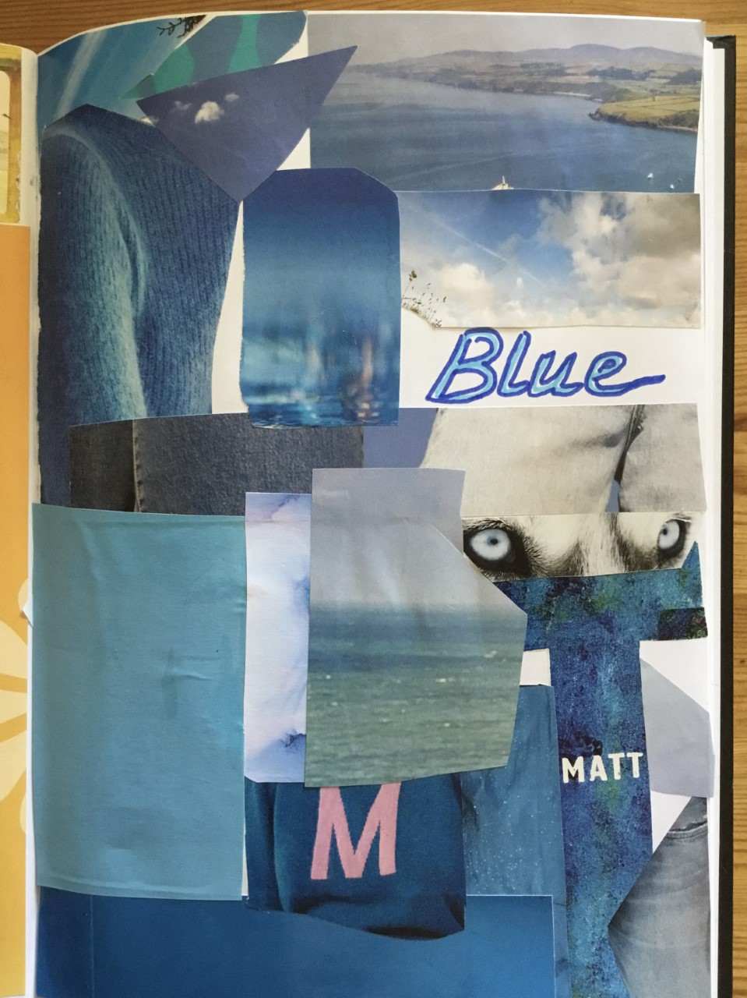
Flag Ideas!!
Sports week is nearly here
(22nd-26th June 2020)
I’ve been designing some flags in our house colours
Using collage
How creative can you be?

Slide 3
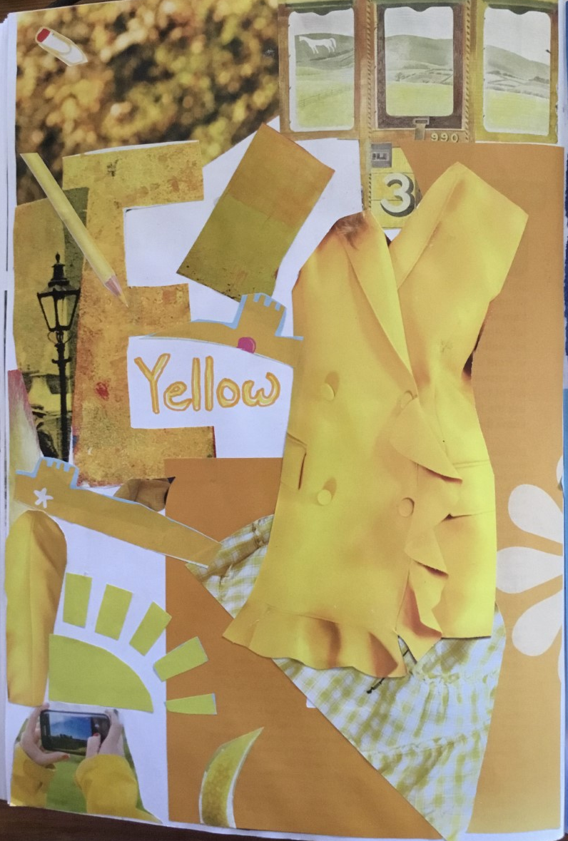
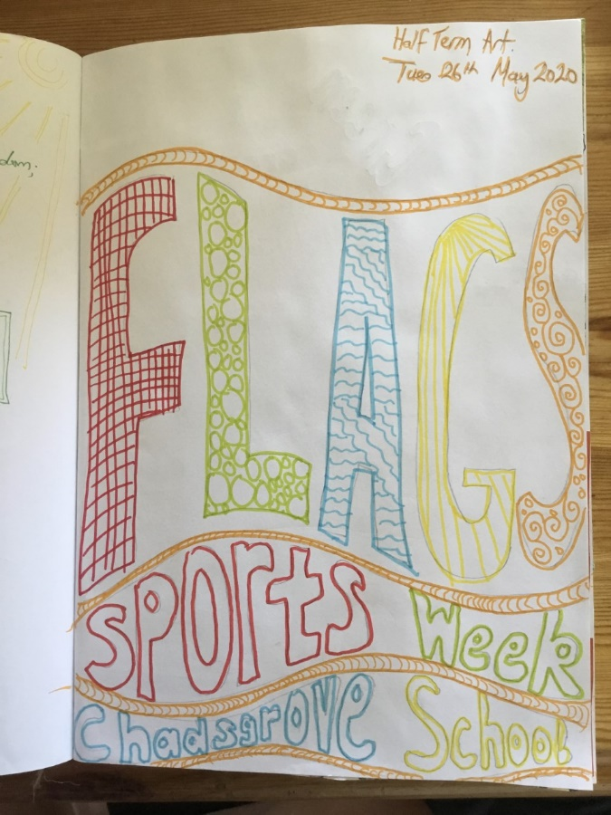
Developing your ideas…
What inspired you?
Your work could be on paper or canvas
Sketch out your picture
Choose colours carefully
Add colours using paint brushes, printing or pen
I have used acrylic paint and pen
You could use paint, pen, printing or collage
Enjoy creating!

Slide 4
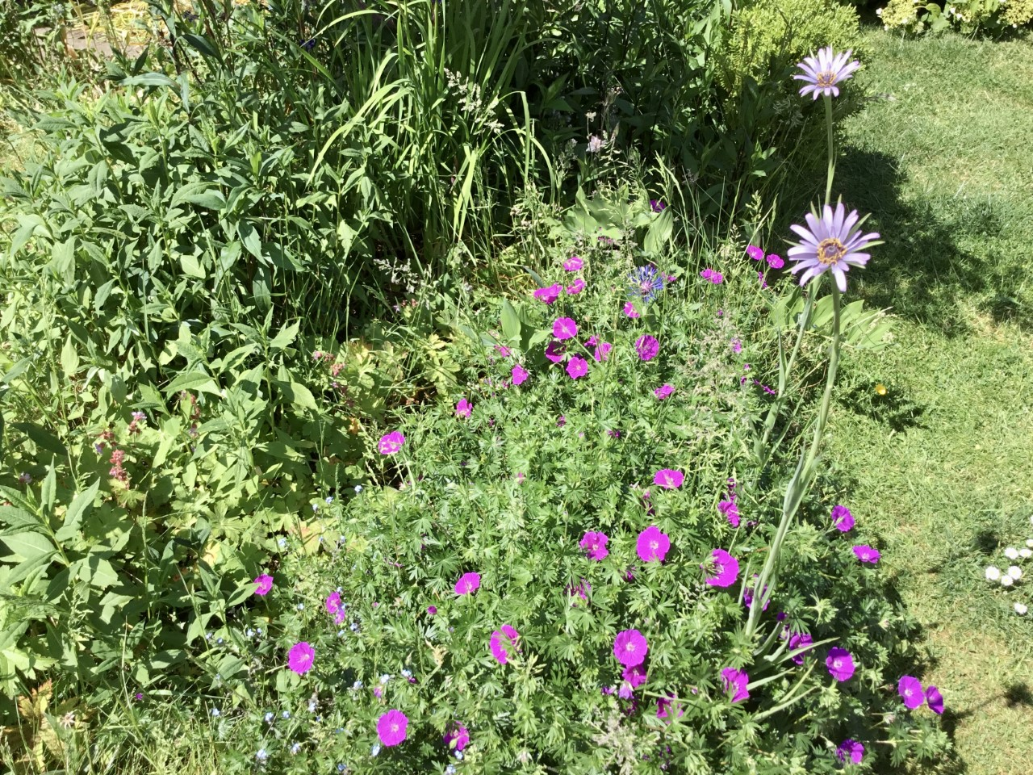
Photographs
Look closely at something that interests you
Take a photograph
Make a picture using your photograph
I used my garden for inspiration

Slide 5
Flowers
Practice with watercolour paints
Use photographs or images to get started
Sketch in pencil
Add a background colour wash
Add details with thicker watercolour paint

Slide 6
Inspiring Words
Think of words that inspire you
Practice your bubble writing
Make it bright and colourful
(if you want to)
Enjoy creating!

