Slide 1
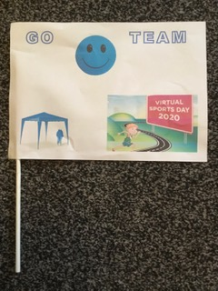
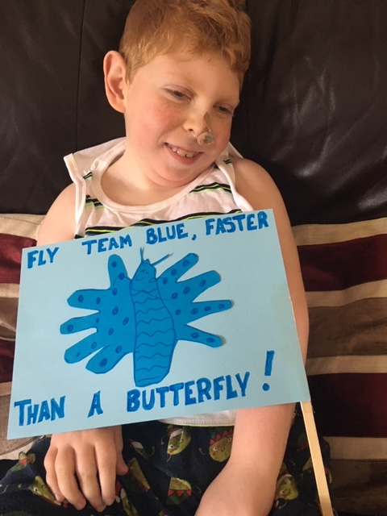
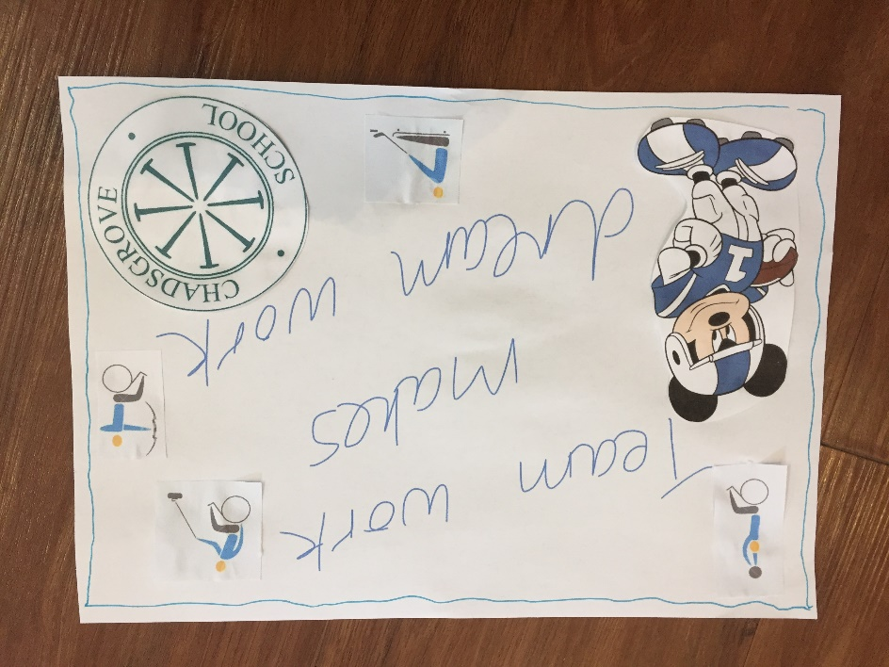
22nd -26th June SPORTS WEEK!!
House Flag Designs
Blue Team

Slide 2
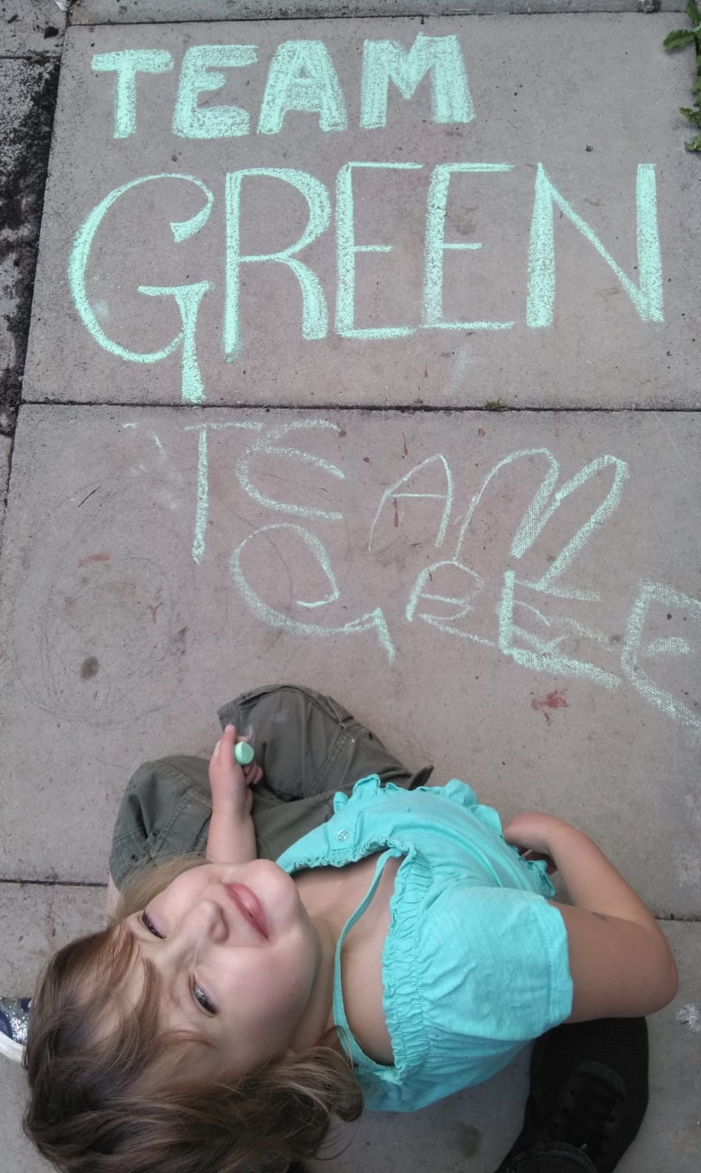
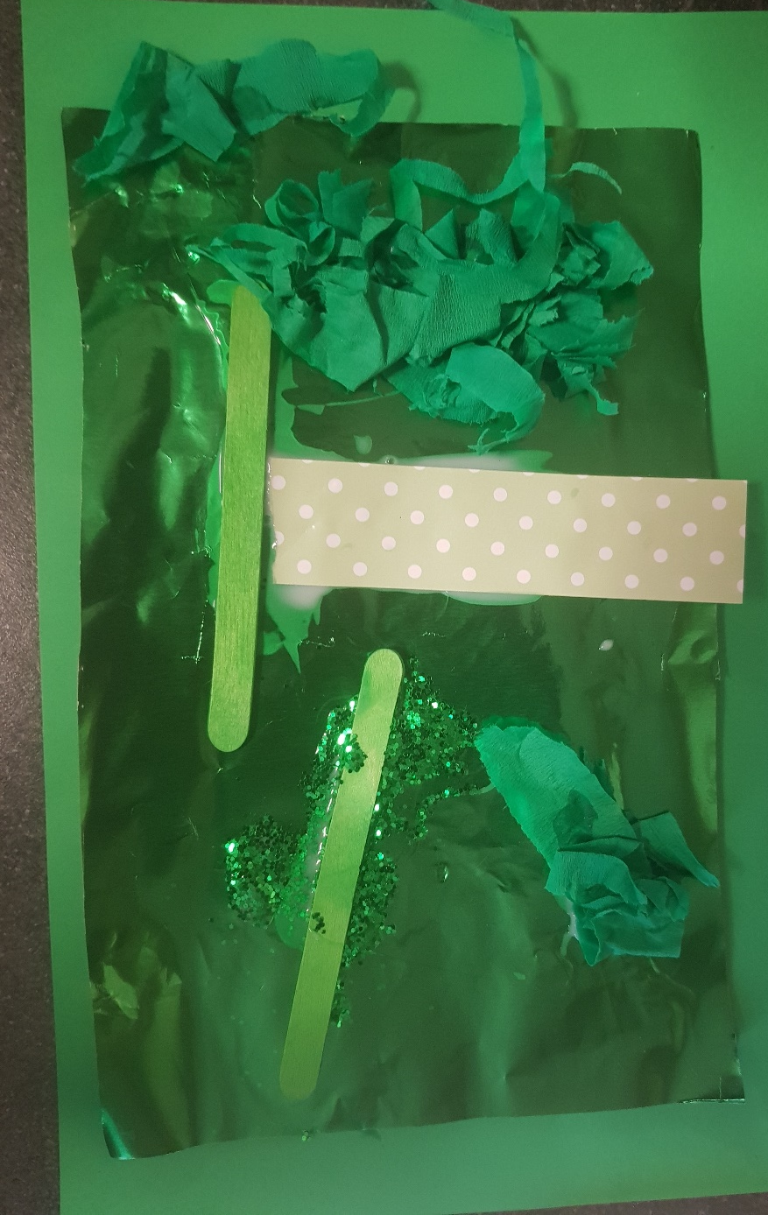
Green Team

Slide 3
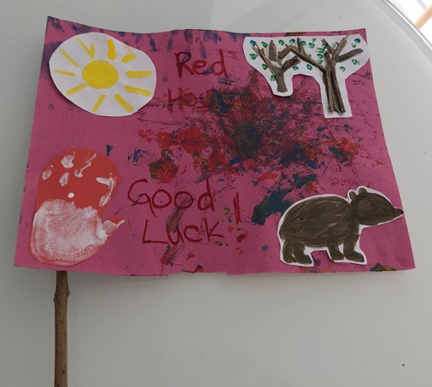
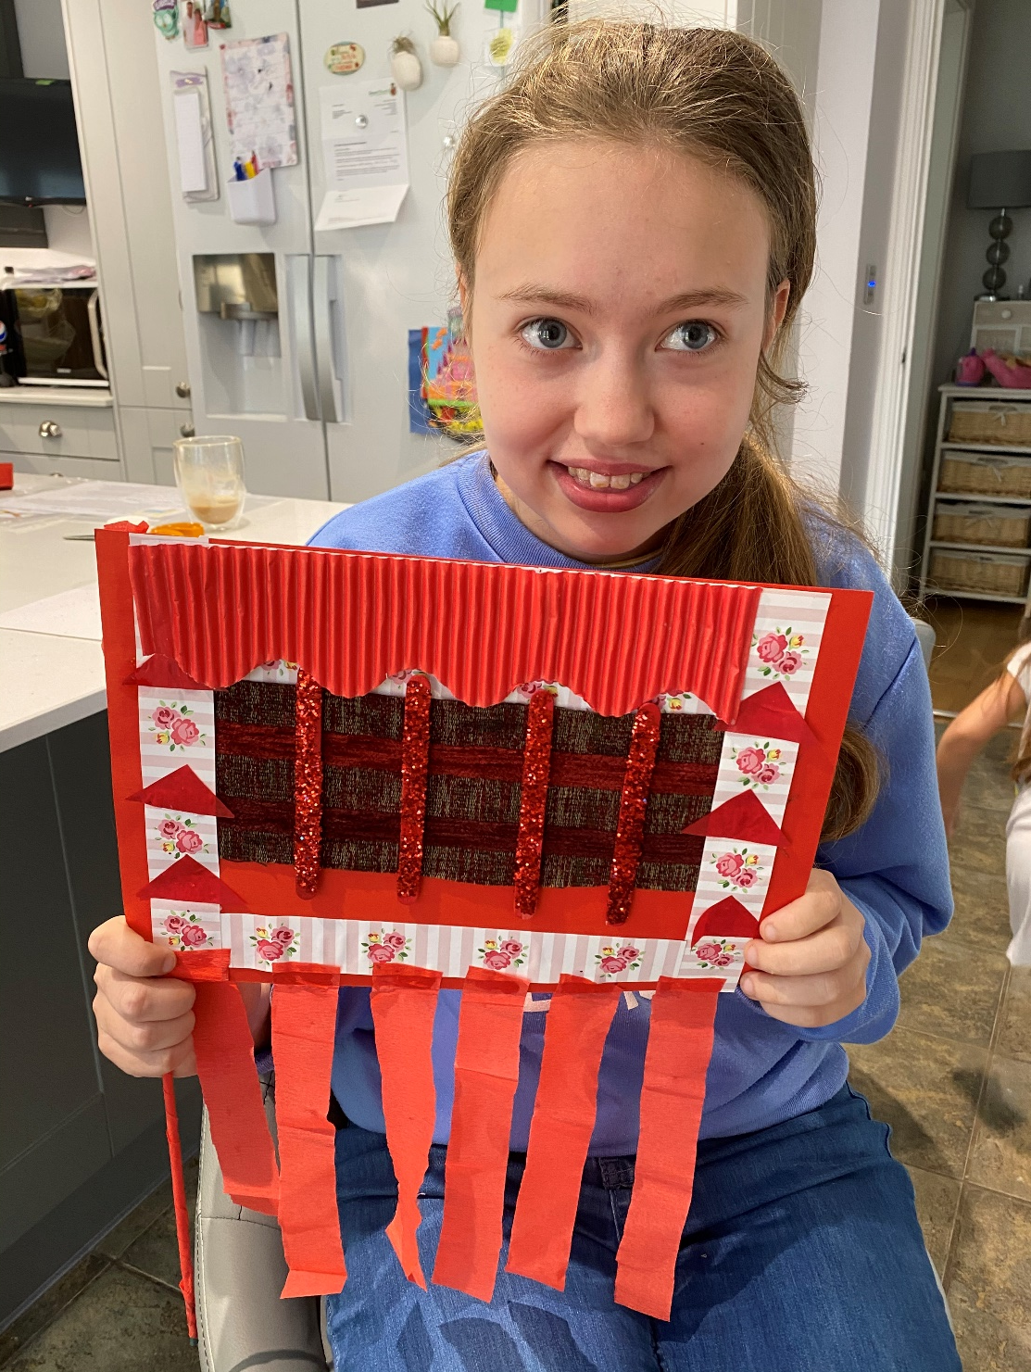
Mosaic idea (group work or on your own)
Red Team

Slide 4
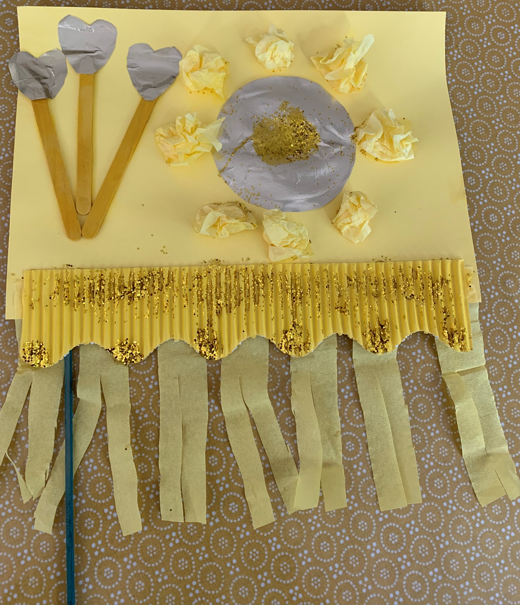
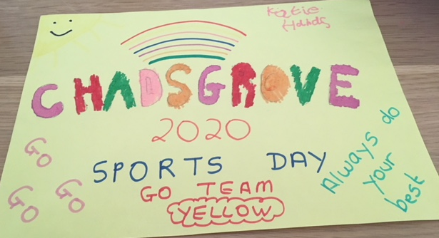
‘Hockney’ Layered
Yellow Team

Slide 5
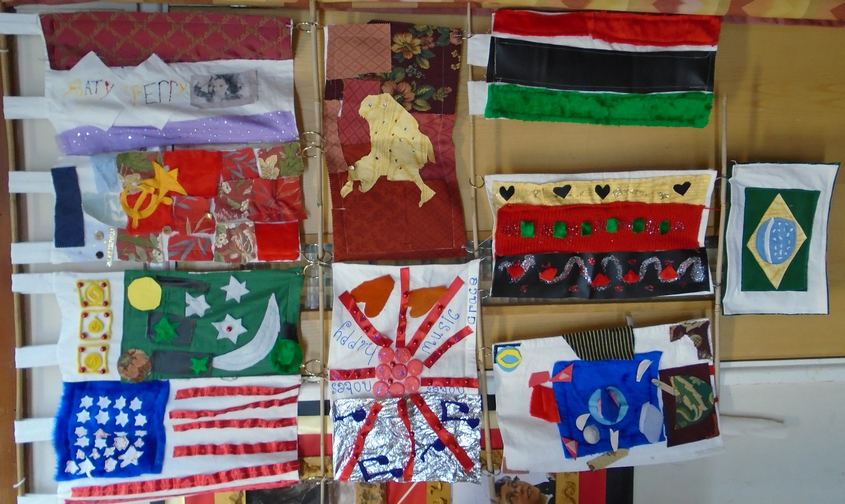
Textiles Flags
Design a flag on paper
Make your design with scraps of material
You could sew
Or you could glue
(These flags were made by 11US in 2016)

Slide 6
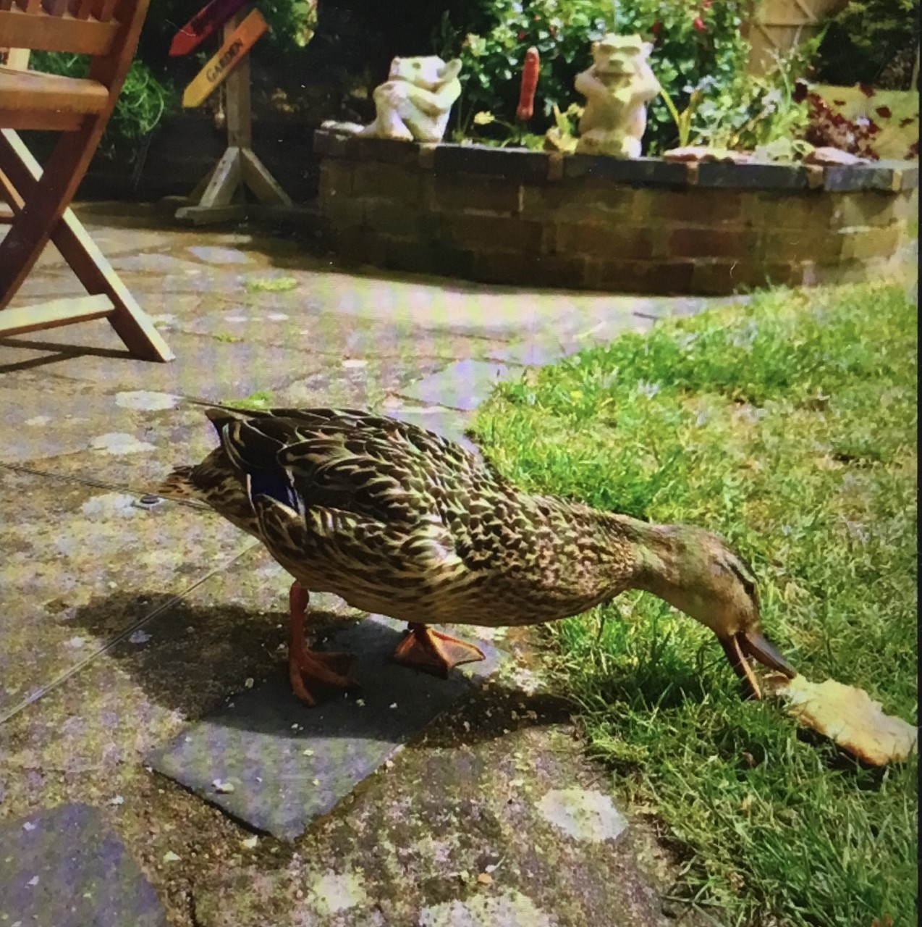
My garden visitor…
Photography is a good skill to practice
What else can I do with this picture?

Slide 7
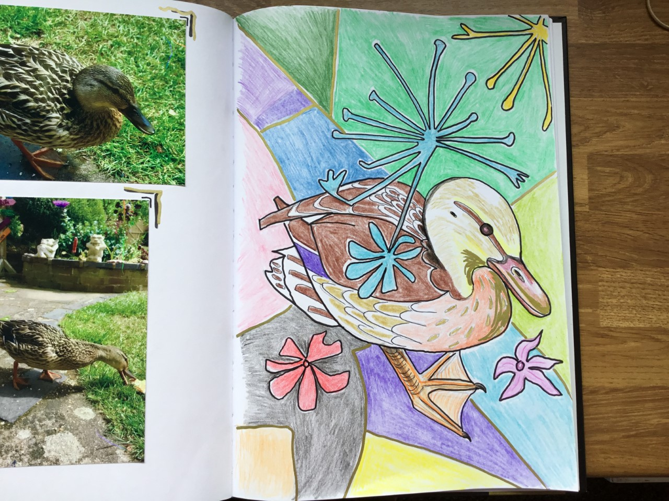
22.6.20
Duck ideas
I drew the duck shape
added details
then added abstract flowers and shapes
used pencil crayon to colour
outlined some detail in black pen
then added some detail in gold

