Slide 1
Gathering your ideas…
What does ‘home’ mean to you?
Your work could be on paper or in your sketchbook
You could make a collage
You could add colour and pattern
You could add words or thoughts
You could practice your bubble writing…
Enjoy creating!

Slide 2
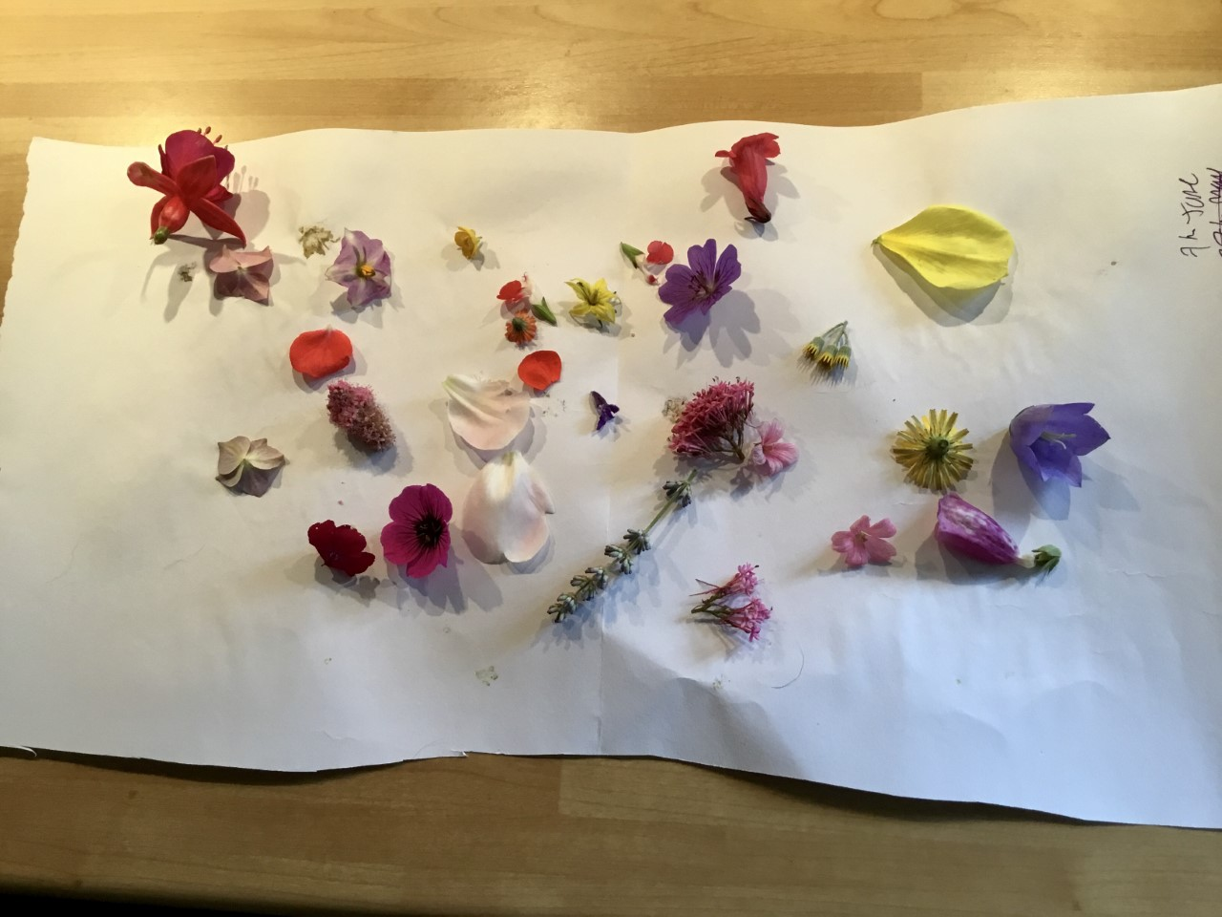
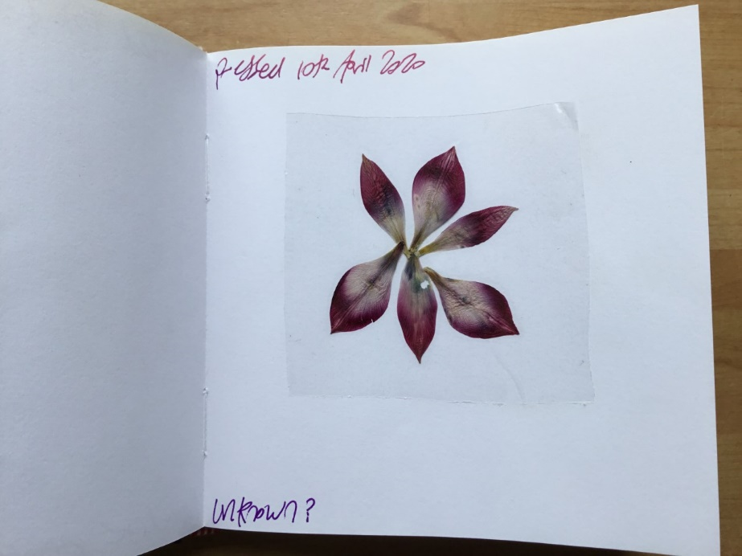
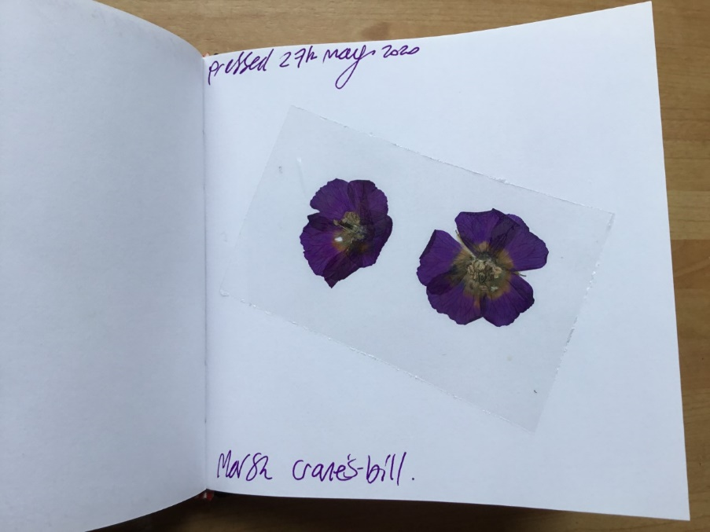
Flower Pressing
Look closely around your garden or when you are out for your exercise
Collect flowers, petals and leaves
Put onto paper, put another piece of paper on top then put under a pile of books
Leave for 6 days
Uncover your petals and flowers, they will be dry and pressed
Add carefully to your sketchbook
Cover with sellotape to keep them safe.

Slide 3
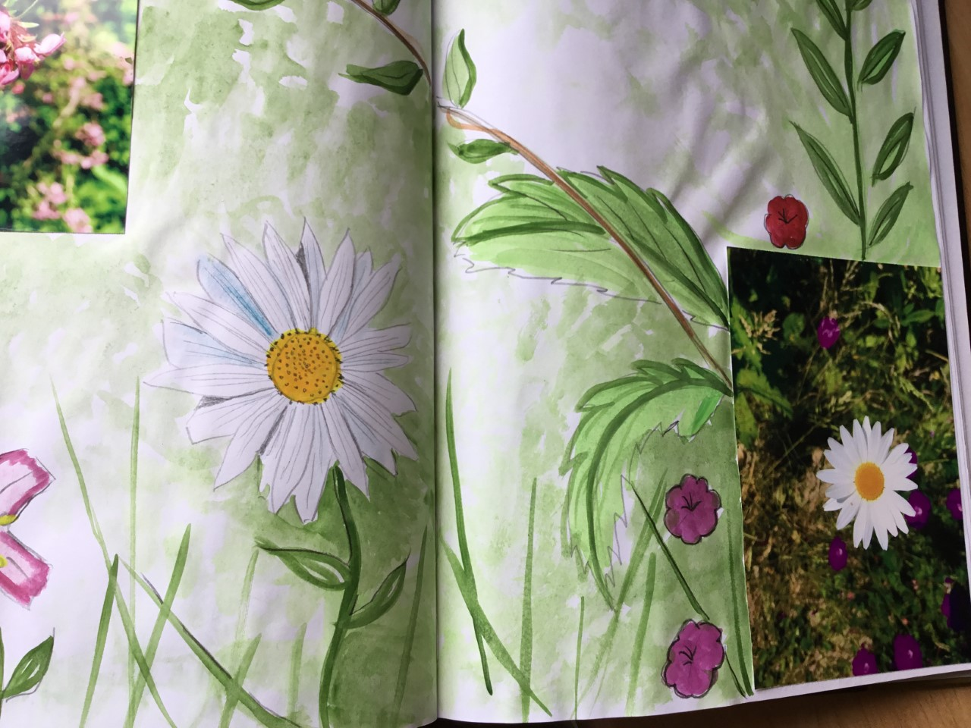
Flowers in my garden
Practice with watercolour paints
Use photographs or images to get started
Sketch in pencil
Add a background colour wash
Add details with thicker watercolour paint
Revisit your work to add more detail as I have here on the flower (using pencil)

Slide 4
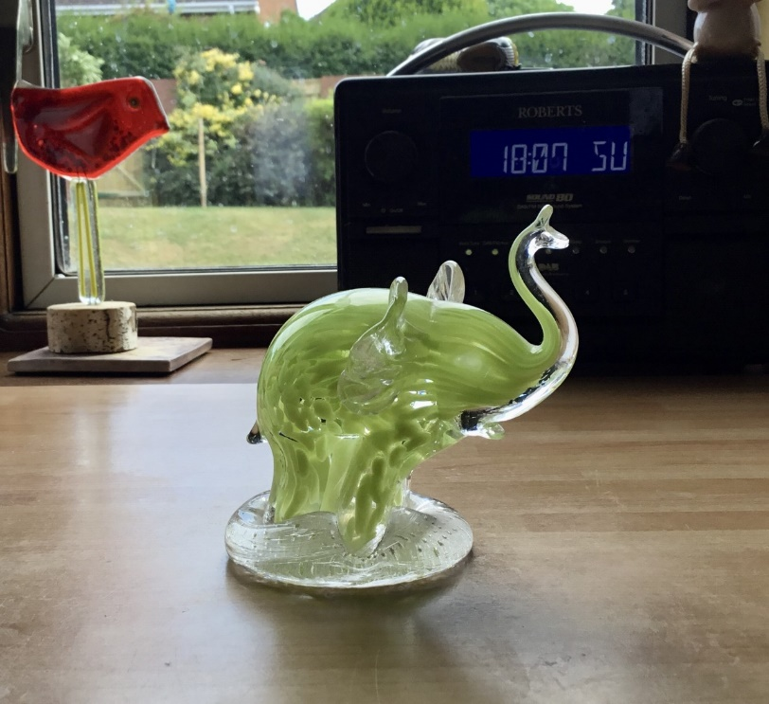
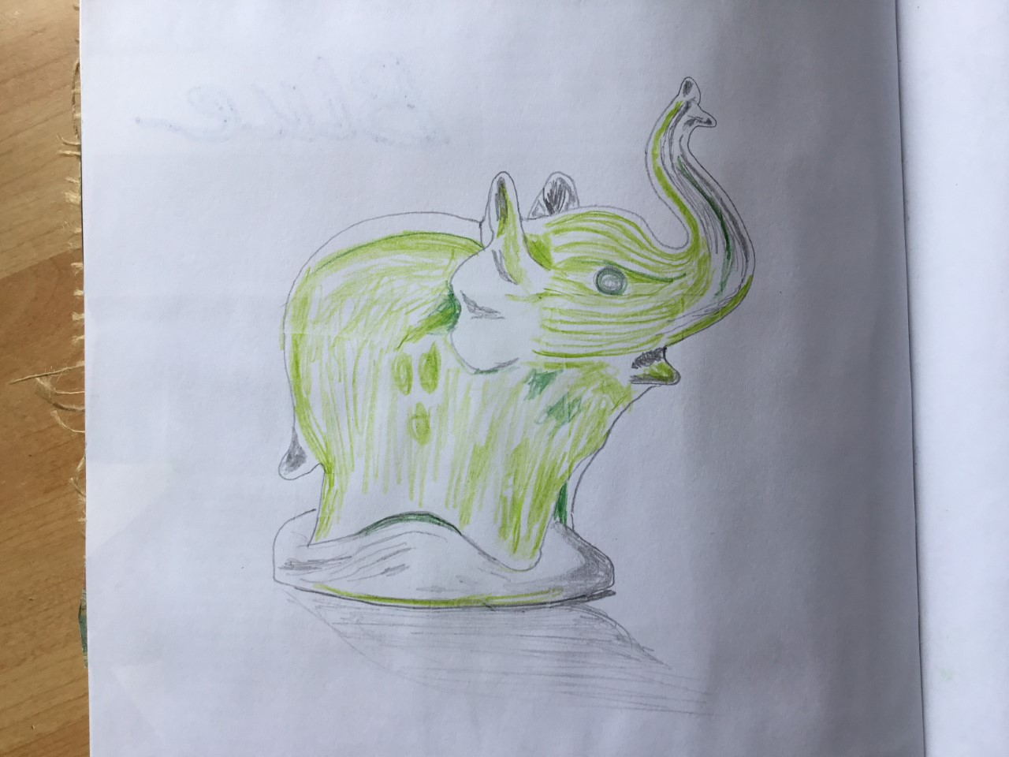
Favourite objects
Elephant! One of my favourite animals. This one is a gift from a former pupil
Look very closely
Sketch out the shape
Fill in the detail
You can use pencil and colour to add interest
I wanted colour to capture the pattern
Practice shading (remember the shadow under the object)

Slide 5
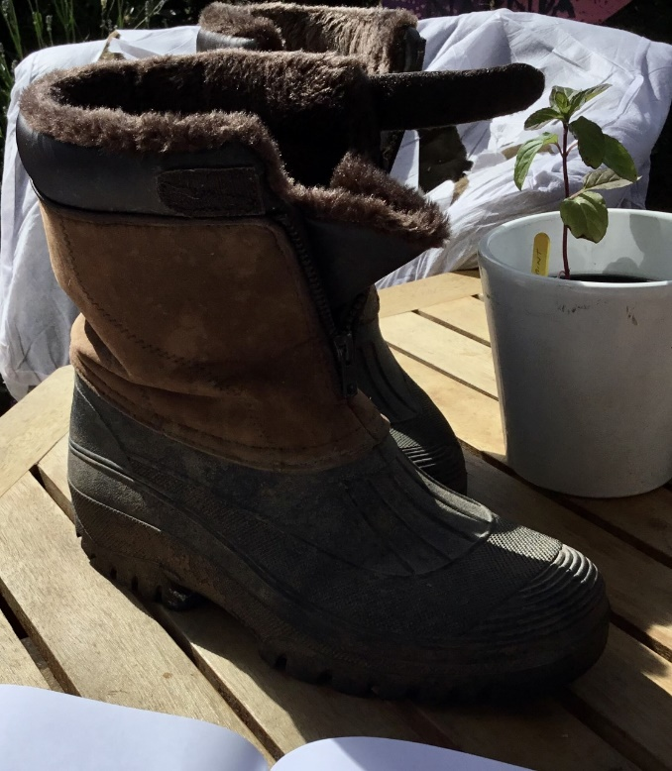
My Dad’s Boots
Choose an object of interest
I chose my dad’s boots because I love them and I wear them in my garden
Draw what you see
Think about shape, line, pattern and shading
There are lots of different textures and patterns
Remember to add the shadow underneath the object

Slide 6
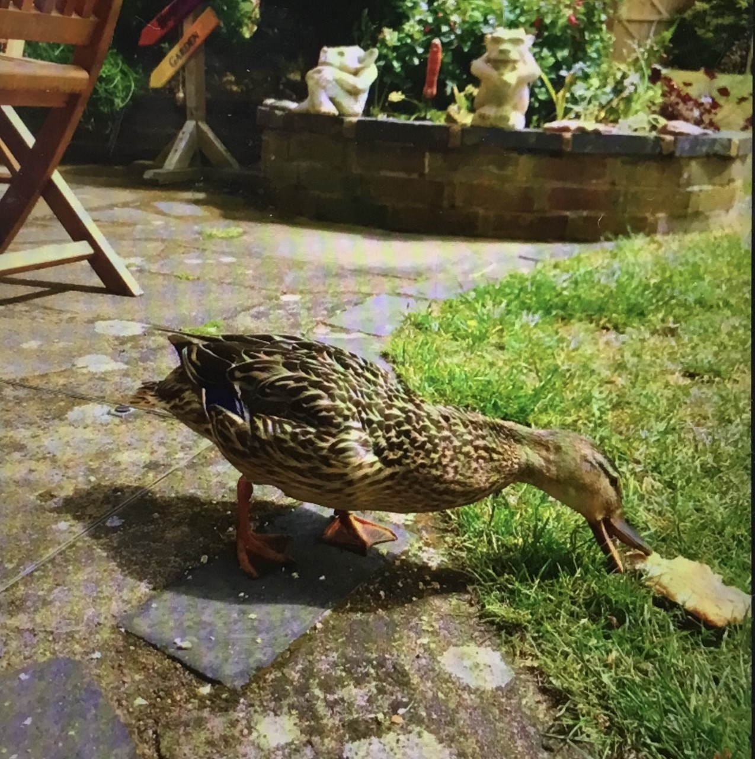
This duck visited my garden so I took some photographs
I am going to think about what art I can do and share it with you all next time…

