Slide 1
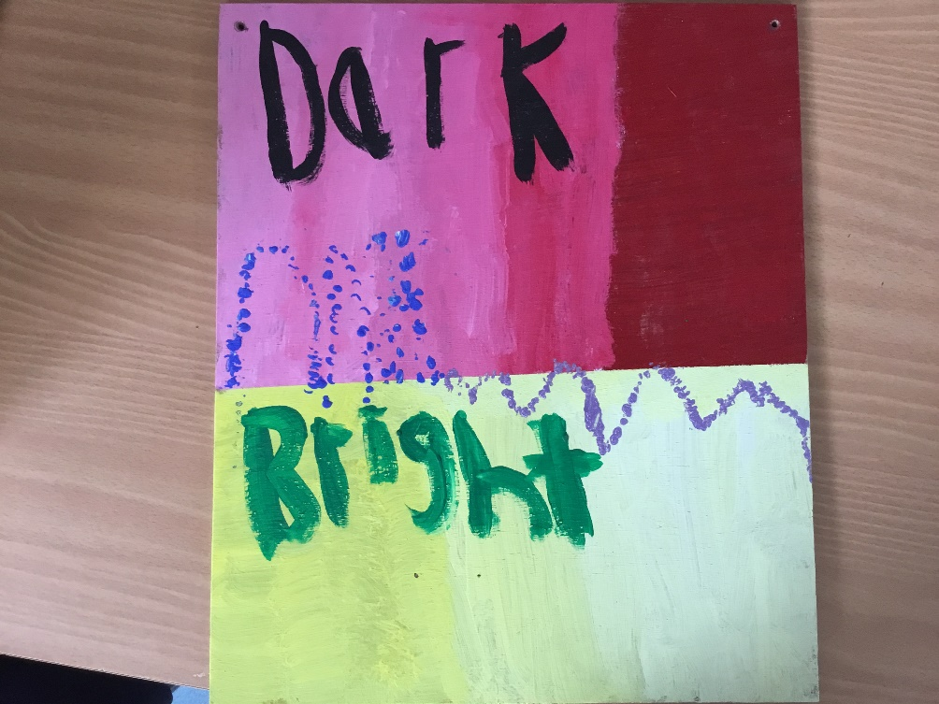
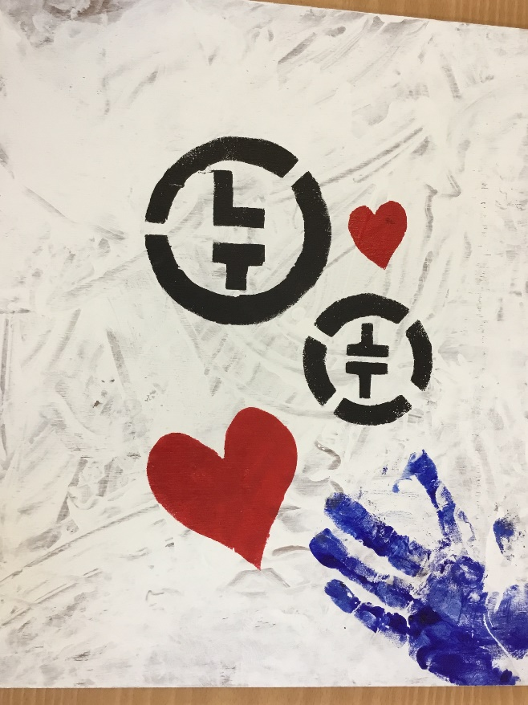
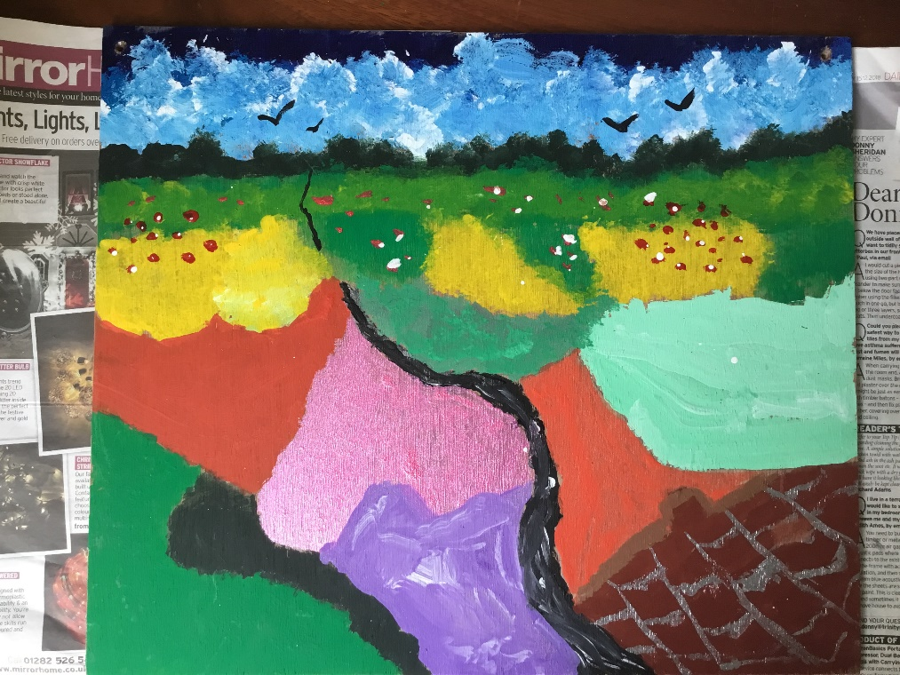
This week I am going to re-visit some work that has been completed during Art lessons at Chadsgrove.
Album Cover
Choose your favourite band or song
Design an album cover
Think about words and logos
Paint onto paper or cardboard
(this work was completed by 15US and 12US in 2019)

Slide 2
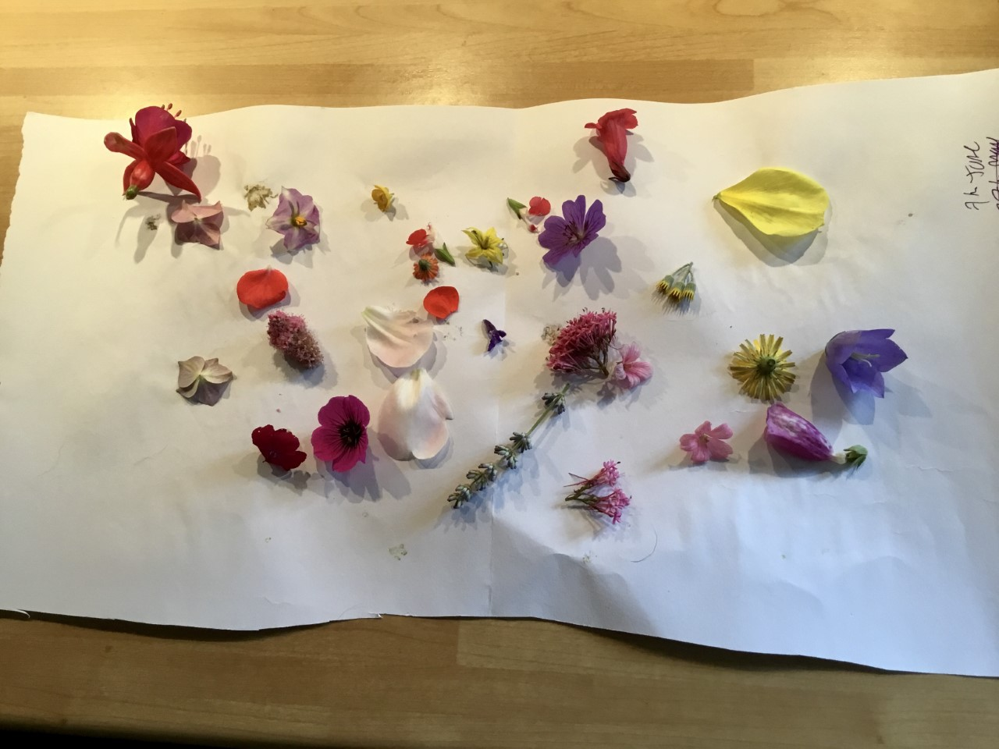
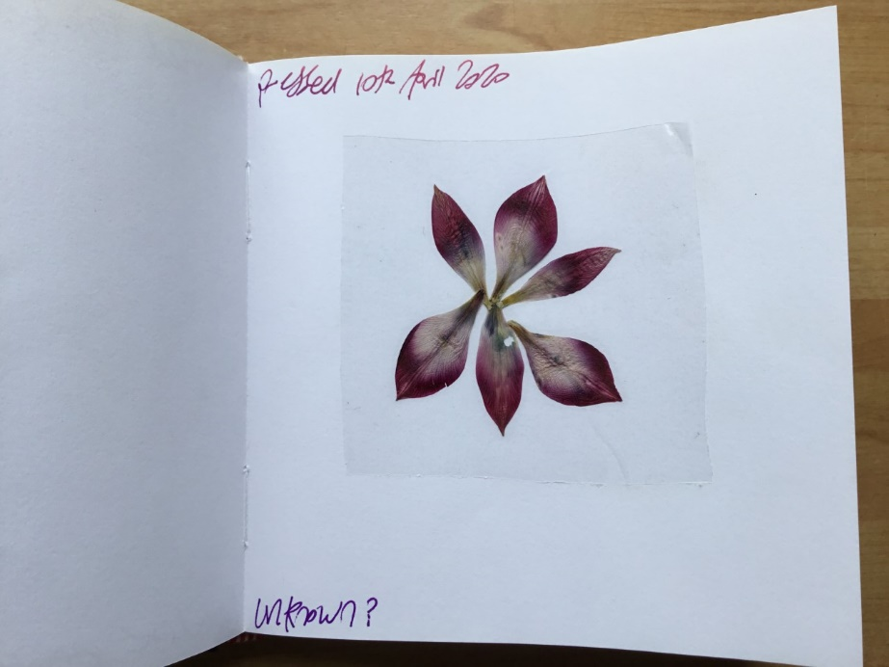
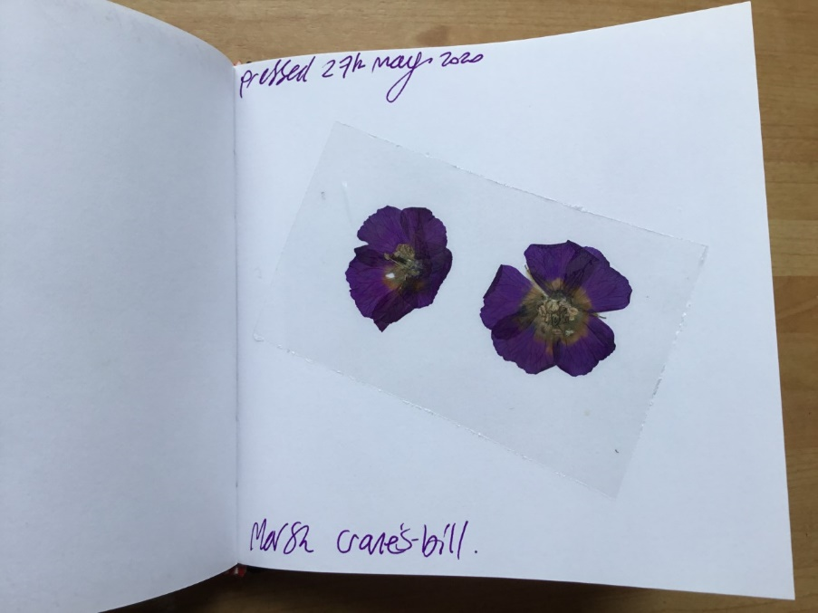
Flower Pressing (revisited)
Look closely around your garden or when you are out for your exercise
Collect flowers, petals and leaves
Put onto paper, put another piece of paper on top then put under a pile of books
Leave for 6 days
Uncover your petals and flowers, they will be dry and pressed
Add carefully to your sketchbook
Cover with sellotape to keep them safe.

Slide 3
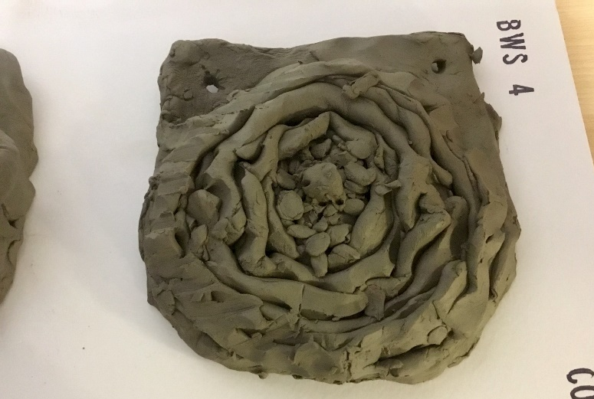
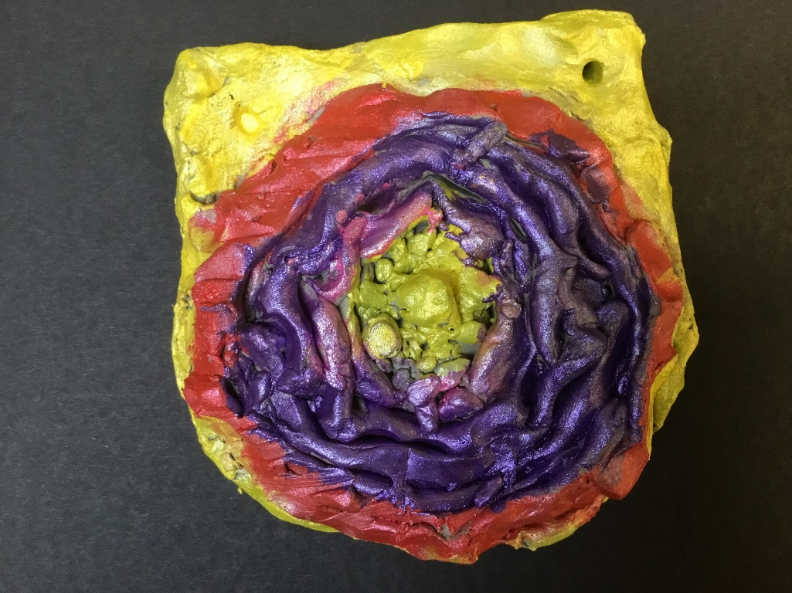
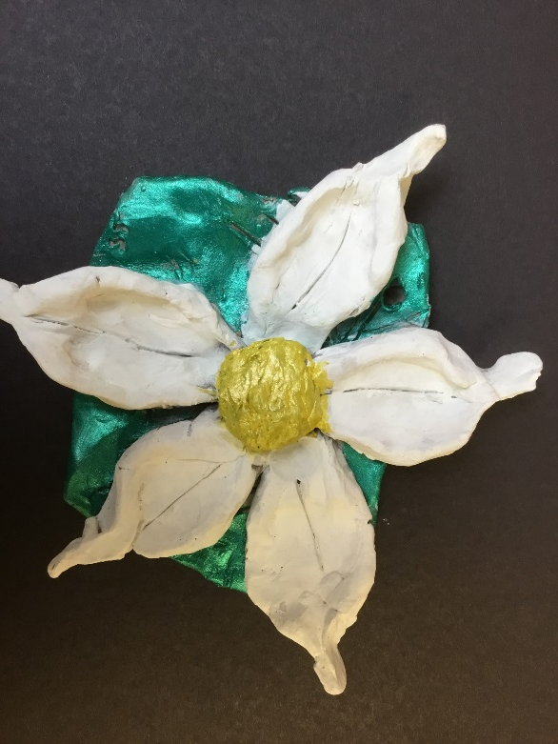
Clay Flowers
Choose your favourite flower
You could sketch or..
You could make a collage
You could add colour and pattern
Now shape out of clay
(let your clay dry for about 5 days)
Now paint your work (acrylic paint is best)
Enjoy creating!
(These flower tiles were made by 11US in 2018)

Slide 4
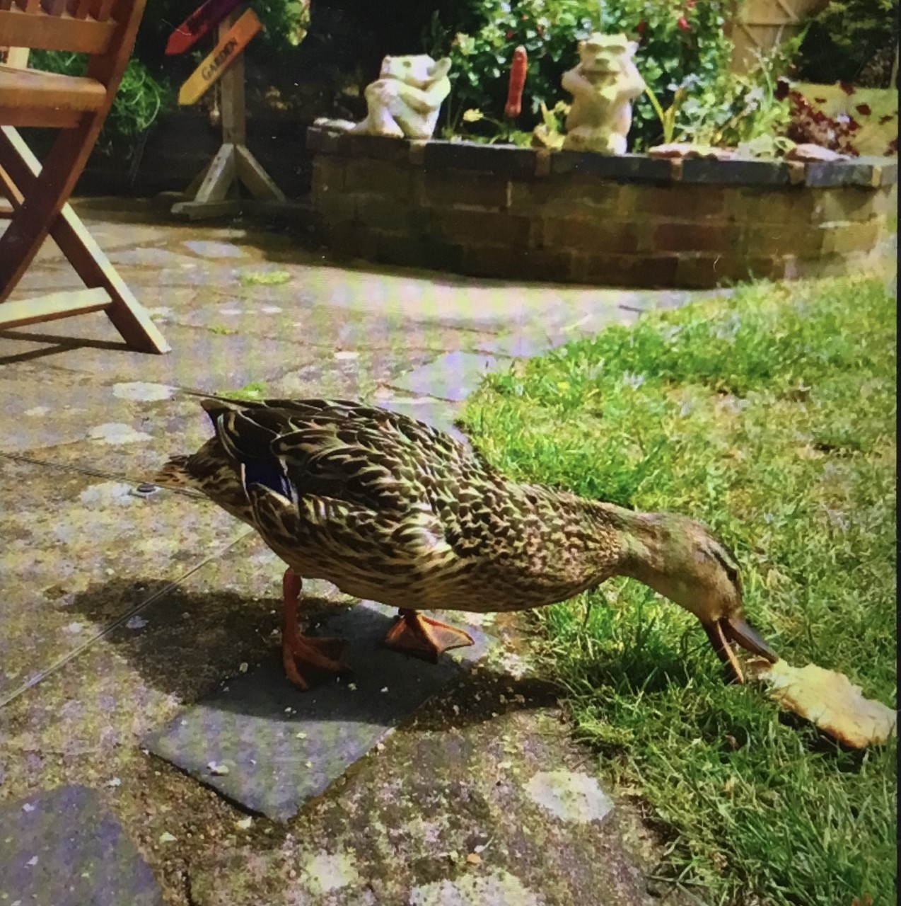
My garden duck!
What birds visit your garden?

Slide 5
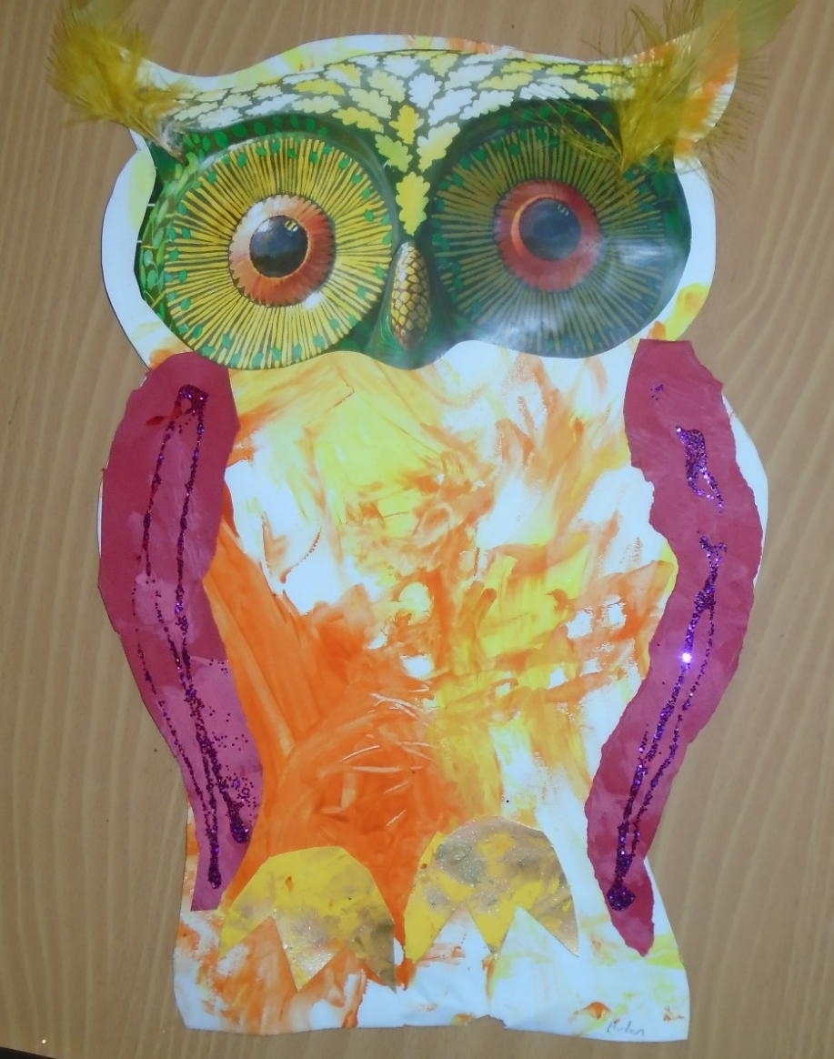
Birds in your garden
Choose a favourite bird
Draw and cut out a shape
Use magazine collage for parts
Practice mark making with paint
Add glitter if you have it
Add feathers or any other texture you choose
(these owls were made by 4LS in 2016!)

Slide 6
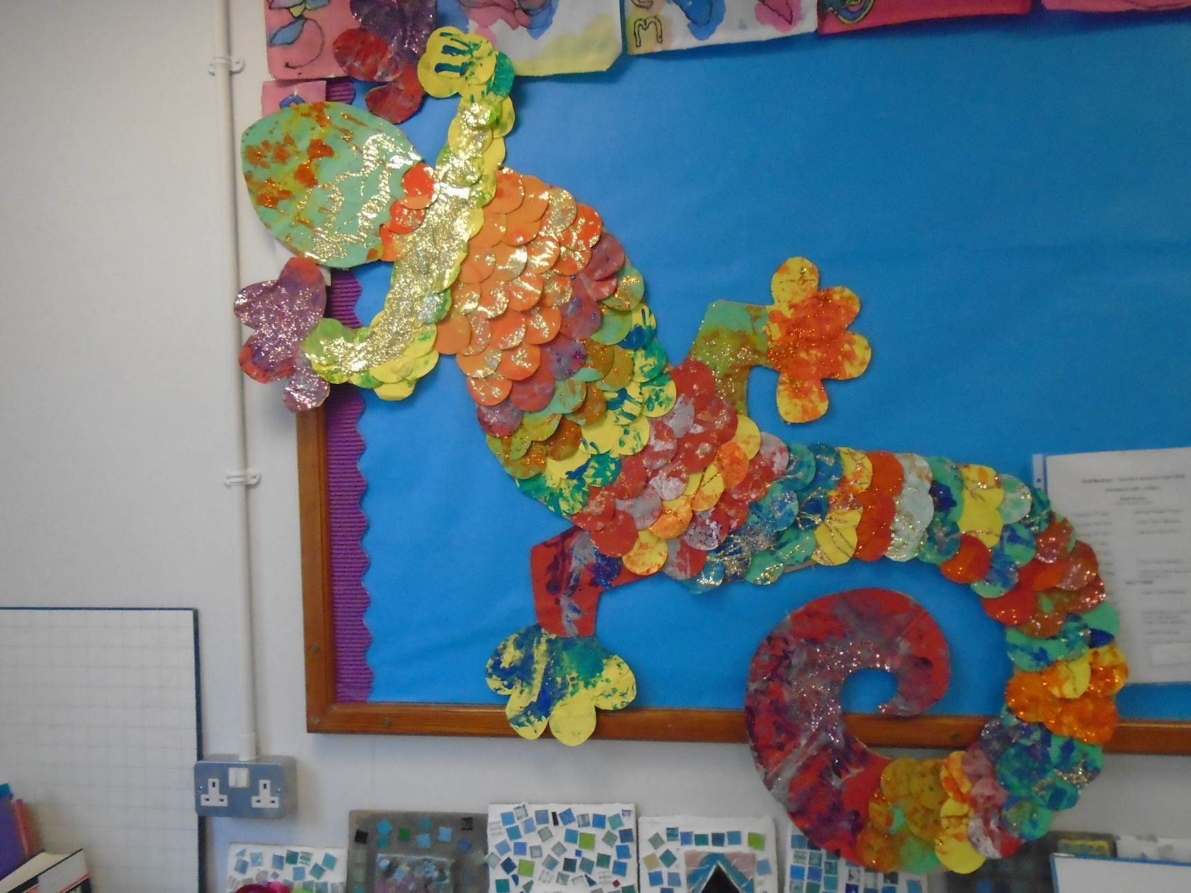
Mosaic idea (group work or on your own)
Have fun painting and mark making
Work with different colour paper, paint and tools
Choose your shape, sketch it out and cut around it (with support)
Cut your painting pages into circles or smaller random shapes
Fill in your larger cut out shape
Add glitter and details!
(This Gecko was made by 4LS in 2016)

Slide 7
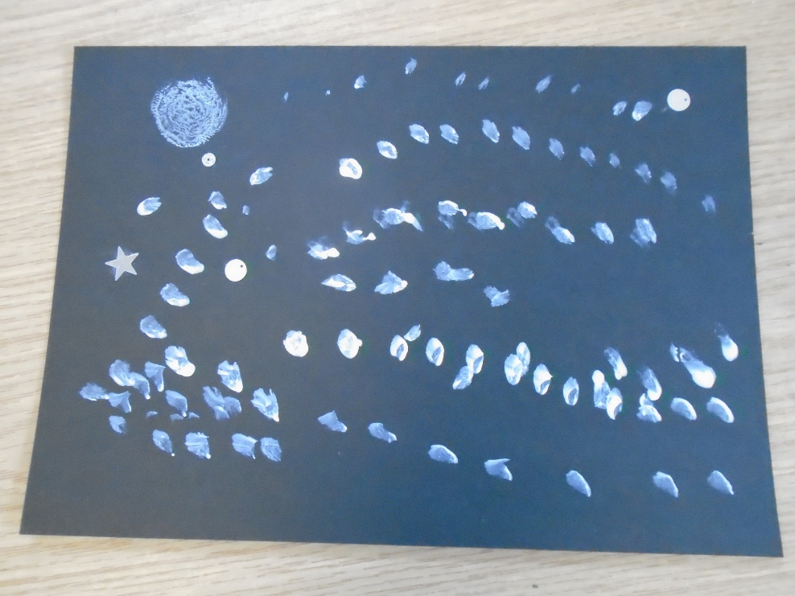
‘Hockney’ Layered Landscapes
Create a sky (paint)
Rip your mid ground, usually mountains or hills
Add detail and stick on top of your sky
Rip or cut the foreground
This may have a fence, trees or houses
You could add a close up branch of a tree
Use lots of different textures and patterns
These layered landscapes were made by 11US in 2016

