Slide 1
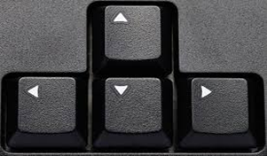
Movement
being aware of Sounds
Remember you will need to click the arrow key
on your PC to move to the next slide

Slide 2
Whilst engaging in this activity, you and your child will experience interaction through shared movement experiences. Your child will have the opportunity to develop an awareness of self (through body awareness and spatial awareness) and the awareness of others (you). You will need: A sheet, or a blanket or if you have one a play parachute Cotton hankies, or natural materials that you can easily waft eg long leaves, long grass Rainmaker, or a homemade version! Eg cardboard tube and rice) Enjoy 10US!

Slide 3
Where ever you see the speaker button you will need to hover the cursor over the and then click on the to activate the song

Slide 4
Whilst your child is being moved onto the floor or somewhere comfortable, click the speaker to play Michael Franti & Spearhead, ‘Once a day’. During this time make your child as comfortable as possible but in a position that enables parts of their body to move.

Slide 5
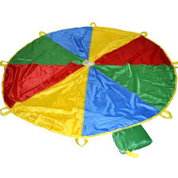
Parachute (if you have one), or table cloth, sheets – to the music, move the material over your child up and down, across and over. Let them experience the textures see the colours/patterns and the feeling of the material as it moves over them.

Slide 6
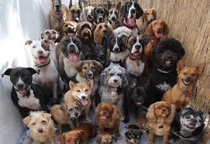
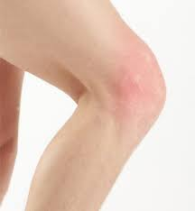
Exploring knees – tapping the knees In time to the music, support your child to tap their knees, help them tap your knees, for independence encourage them to tap their own knees and yours .

Slide 7
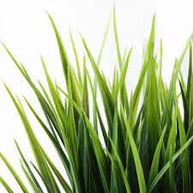
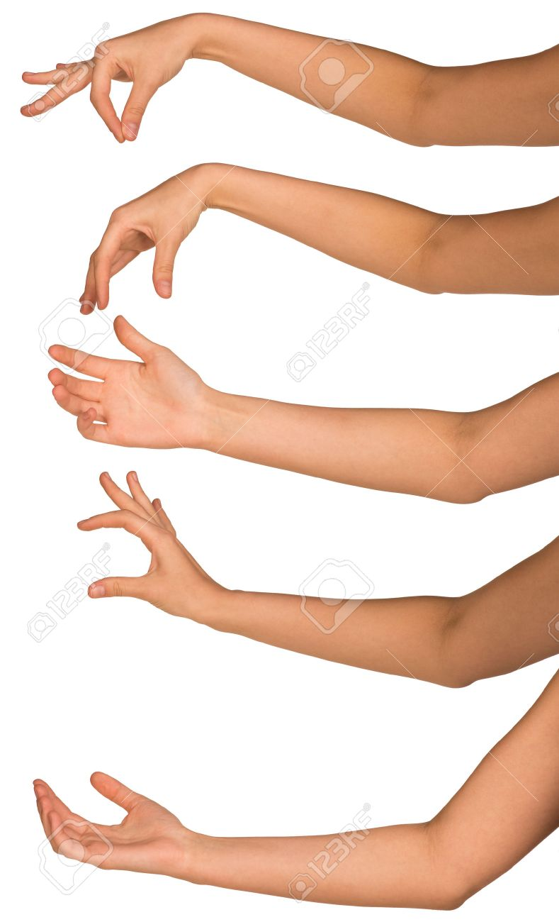
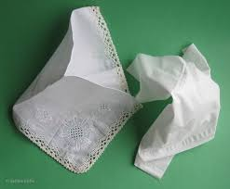
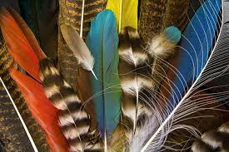
Swaying arms using natural materials (if possible) Support your child’s arms whilst they are lay down, raising their arms and swaying them side to side & back and forth, do this whilst holding the different materials As the music plays, talk to your child about the different sounds of nature (hover the curser on the main picture in the middle and the play button will be appear)

Slide 8
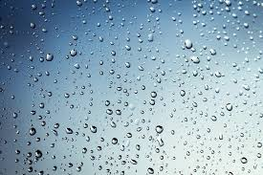
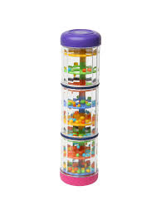
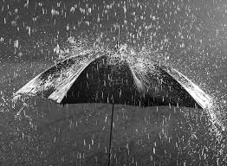
Rainmakers – using a rainmakers (or homemade version) Roll up and down your child’s body, let them explore the rainmaker and help them make the sounds moving their hands, wrists and arms.

Slide 9
Reflecting – using blankets, fabric or parachute place over your child, listen to the music and think about all the different movements you have shared together. (Hover the cursor on the main picture in the middle and the play button will be appear)

Slide 10
Relax, enjoy the rainbow it’s the end of your ‘sounds’ movement lesson

