Slide 1
Celebrating the hard work of Chadsgrove pupils DofE sections at home
DofE with a difference
3.5.20

Slide 2
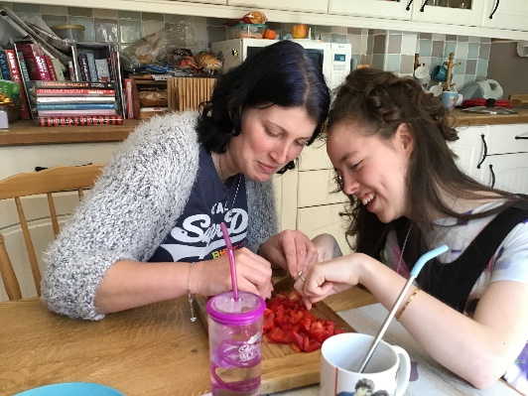
Helping to make lunch for the family
Helping around the house

Slide 3
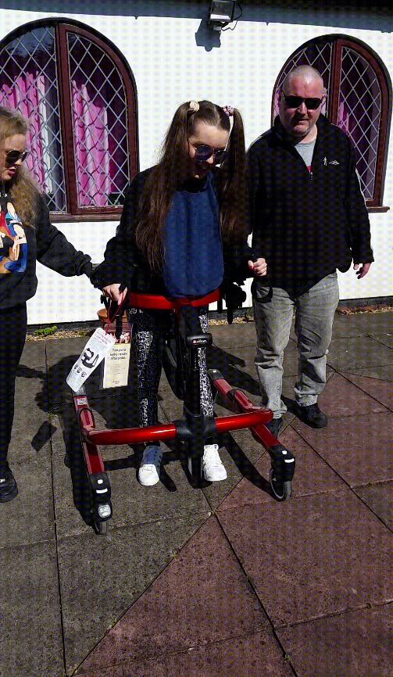
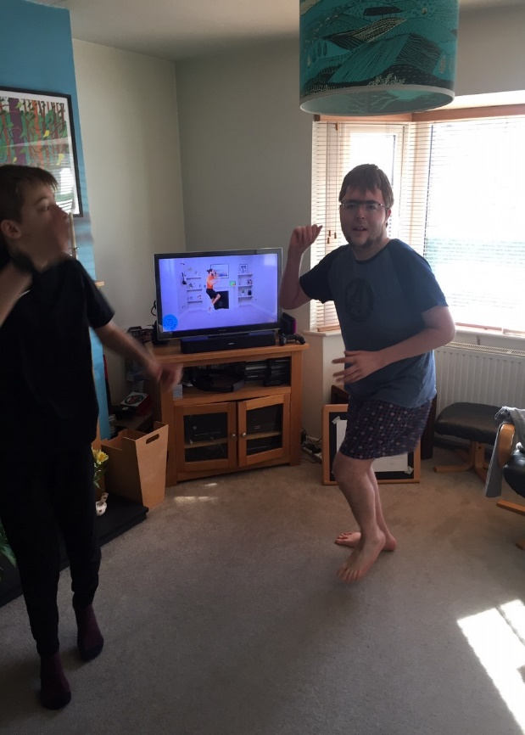
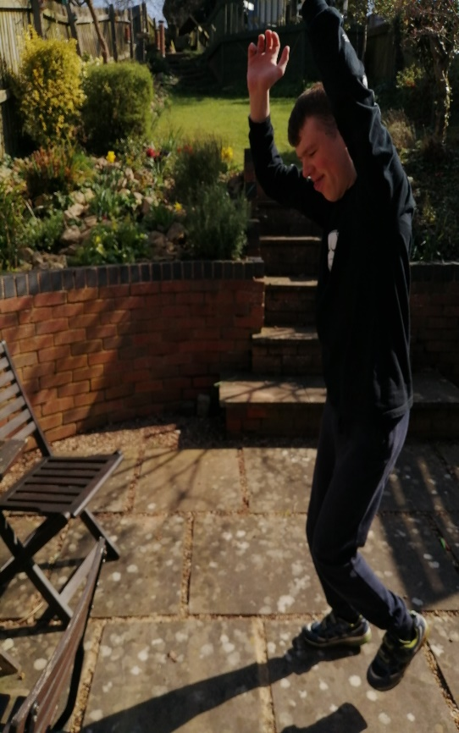
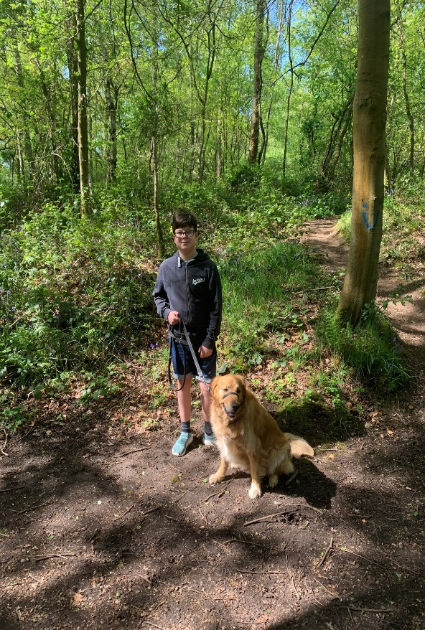
Walking the dog
Physio walking & standing
P.E with Joe Wicks
Keep fit in the garden

Slide 4
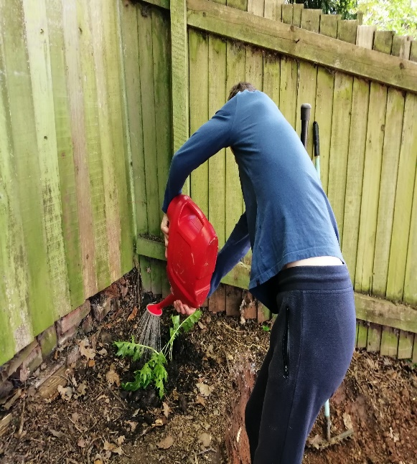
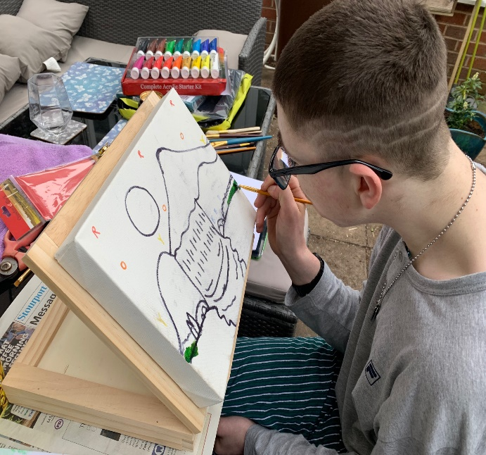
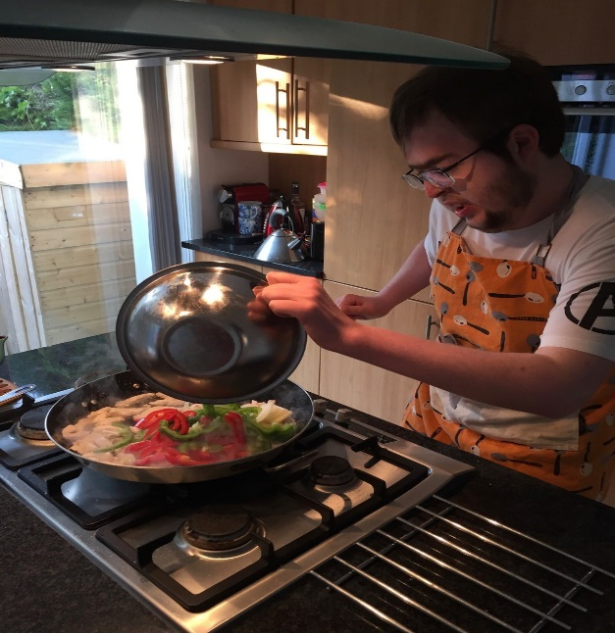
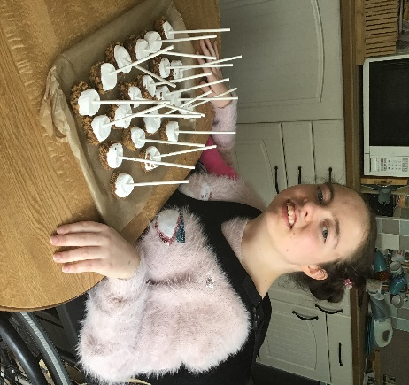
Gardening- Planting and growing
Art- Drawing and Sketching
Making snacks
Cooking a meal

Slide 5
Well done everyone- Your updates and photos are amazing!
Please keep up the hard work!
Send all your photos and updates to me by email or if the files are too big use WeTransfer
My email address is: ejn24@chadsgrove.worcs.sch.uk

